Slide 1
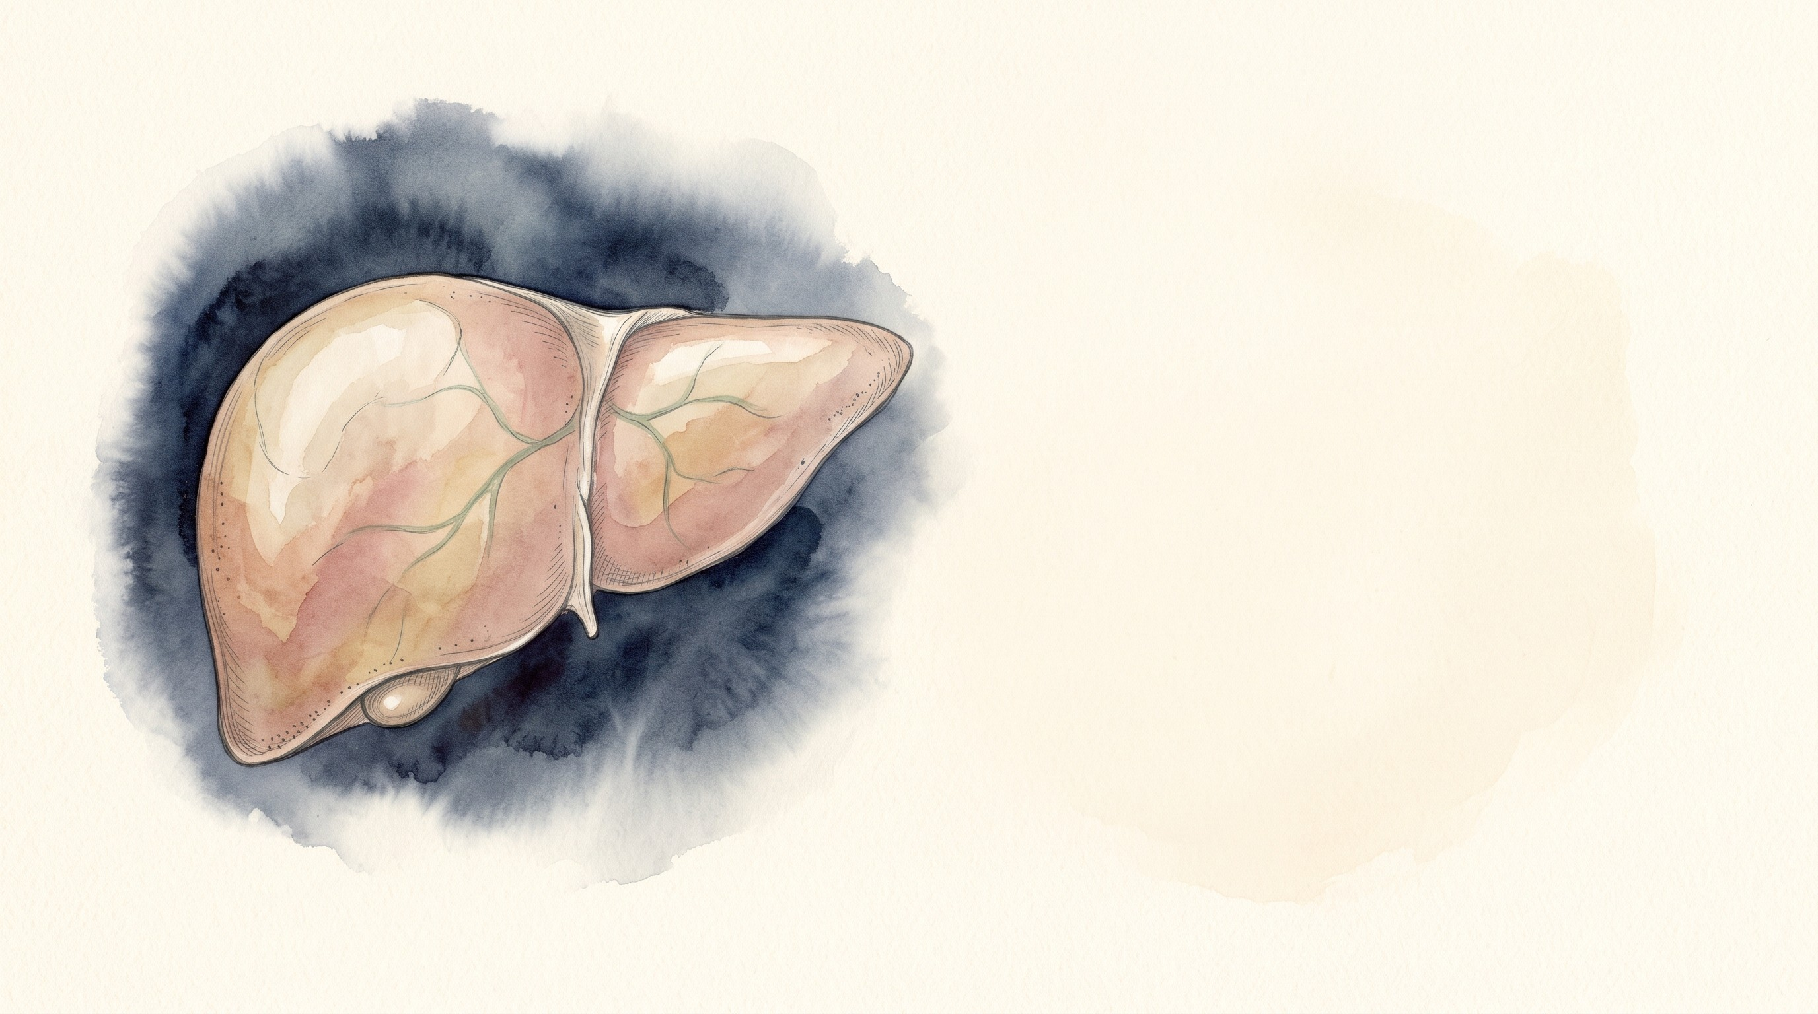


Acute Liver Failure
and ACLF in the ICU
Mohammad Almeqdadi, MD
Transplant Hepatologist and Gastroenterologist
Assistant Professor of Medicine and Surgery
X: @mfalmeqdadi
Slides (PDF)
Illustrations generated with Google Gemini
Notes:
Pulmonary and critical care fellows. About 60 minutes with questions as we go. Two patients in the unit at the same time. Everything in the cases is made up for teaching; none of it is a real patient.

Slide 2
Objectives
By the end of this talk you should be able to:
Tell acute liver failure apart from severe acute liver injury and from ACLF
Plan the first hour of care in ALF
Manage the brain and the ammonia in ALF
Recognize and grade ACLF, and find the trigger
Work through AKI in cirrhosis
Know when to call transplant hepatology
2/58
Notes:
We'll get to each of these through two patients who are in the unit at the same time.

Slide 3
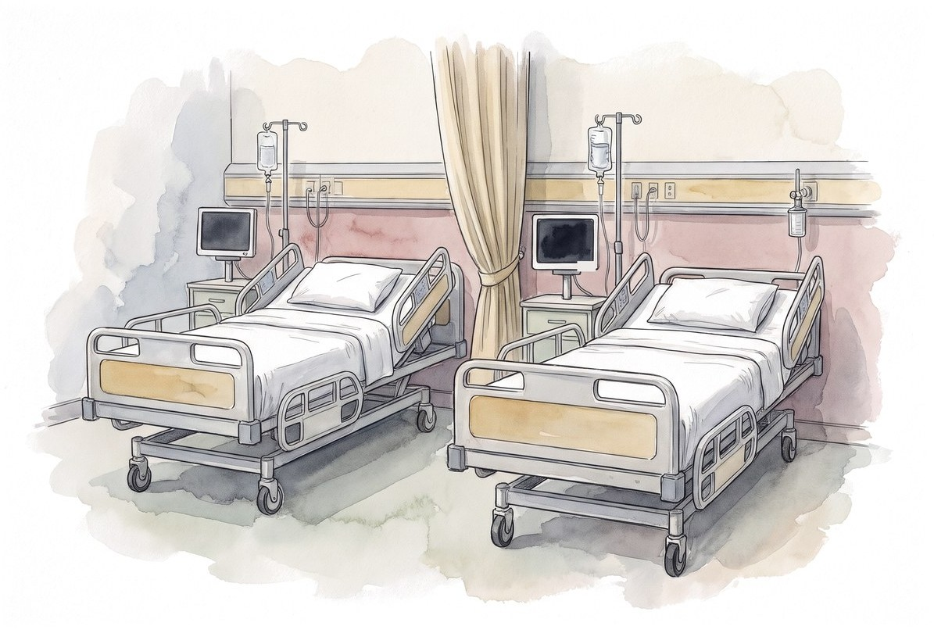
Bed 4 and bed 7
Bed 4 | Bed 7
28-year-old woman | 56-year-old man
No known liver disease | Alcohol-related cirrhosis with ascites
Nausea and vomiting for 4 days | Fever, confusion, low blood pressure
Is it the same disease?
3/58
Notes:
Introduce both up front so the contrast is there from the start. We'll start with bed 4 and come back to bed 7.

Slide 4

Bed 4
28F, 4 days of nausea
4/58
Notes:
First patient.

Slide 5
28F, 4 days of nausea
Nausea, vomiting and poor intake for 4 days
No known liver disease, no alcohol use
"Took something for a toothache"
Test | Result
AST | 6,820 U/L
ALT | 5,940 U/L
ALP | 128 U/L
Bilirubin | 2.9 mg/dL
Creatinine | 1.0 mg/dL
Is this acute liver failure?
5/58
Notes:
Let them commit. Most people will say yes because the numbers are huge. The aminotransferases tell you hepatocytes are dying. They don't tell you whether the liver is failing.

Slide 6
28F, 4 days of nausea
Nausea, vomiting and poor intake for 4 days
No known liver disease, no alcohol use
"Took something for a toothache"
Test | Result
AST | 6,820 U/L
ALT | 5,940 U/L
ALP | 128 U/L
Bilirubin | 2.9 mg/dL
Creatinine | 1.0 mg/dL
Is this acute liver failure?
We don't know yet. What's missing?
5/58
Notes:
This is the same distinction as in the acute liver injury lecture: the size of the enzyme rise is not the severity of the illness.

Slide 7
28F, 4 days of nausea
Nausea, vomiting and poor intake for 4 days
No known liver disease, no alcohol use
"Took something for a toothache"
Test | Result
AST | 6,820 U/L
ALT | 5,940 U/L
ALP | 128 U/L
Bilirubin | 2.9 mg/dL
Creatinine | 1.0 mg/dL
What's missing?
INR (synthetic function, not enzymes)
Mental status (any encephalopathy?)
Time course (how long since the first symptom?)
Is there chronic liver disease underneath?
5/58
Notes:
Liver failure is a clinical diagnosis: coagulopathy plus encephalopathy in someone without cirrhosis. Ask for the INR and examine the patient.

Slide 8
28F, 4 days of nausea
Disoriented to time, asterixis. Still there after the glucose is fixed
Symptoms started 4 days ago
Ultrasound: smooth liver, no ascites, patent vessels, normal spleen
No history or imaging suggesting cirrhosis
Test | Result
AST | 6,820 U/L
ALT | 5,940 U/L
Bilirubin | 2.9 mg/dL
INR | 3.2
Glucose | 54 mg/dL
6/58
Notes:
Coagulopathy, encephalopathy, short course, no cirrhosis. Note the glucose: hypoglycemia is part of the picture, and it is also a reason the mental status can look worse than it is. Fix the glucose and re-examine.

Slide 9
28F, 4 days of nausea
Disoriented to time, asterixis. Still there after the glucose is fixed
Symptoms started 4 days ago
Ultrasound: smooth liver, no ascites, patent vessels, normal spleen
No history or imaging suggesting cirrhosis
Test | Result
AST | 6,820 U/L
ALT | 5,940 U/L
Bilirubin | 2.9 mg/dL
INR | 3.2
Glucose | 54 mg/dL
This is acute liver failure
6/58
Notes:
Coagulopathy, encephalopathy, short course, no cirrhosis. Note the glucose: hypoglycemia is part of the picture, and it is also a reason the mental status can look worse than it is. Fix the glucose and re-examine.

Slide 10
Acute liver failure
INR ≥ 1.5 and any degree of encephalopathy
Illness of less than 26 weeks
No pre-existing cirrhosis
  AASLD and ACG: chronic liver disease without cirrhosis still allows ALF. EASL: no prior liver disease at all
  Wilson disease, autoimmune hepatitis and vertically acquired HBV can still count if recognized within 26 weeks
Jaundice to encephalopathy | Hyperacute (< 1 week) | Acute (1 to 4 weeks) | Subacute (4 to 12 weeks)
Typical causes | Acetaminophen, HAV, HEV, ischemia | HBV | DILI, AIH, unknown cause
Cerebral edema | Common | Less common | Uncommon
Spontaneous recovery | More likely | Intermediate | Less likely
EASL ALF guideline 2017 [PMID: 28417882]; ACG ALF 2023 [PMID: 37377263]; Management of ALF: update 2022 [PMID: 36001996]
7/58
Notes:
The time course is not trivia. The faster it comes on, the more you worry about the brain, and paradoxically the better the chance of spontaneous recovery. The slow ones have less cerebral edema but do worse without a transplant. Patient A is hyperacute.

Slide 11
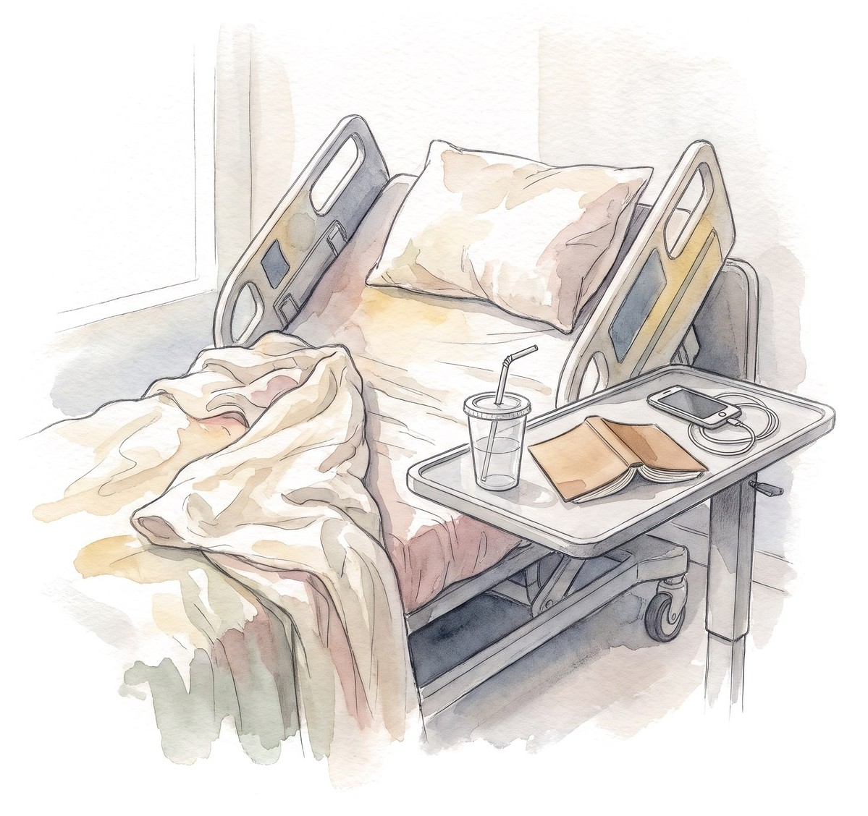
Same patient, but wide awake
Same labs and INR 2.4, but fully oriented with no asterixis
What do you call this, and what do you do now?
8/58

Slide 12
Same patient, but wide awake
Same labs and INR 2.4, but fully oriented with no asterixis
Severe acute liver injury, not ALF yet
No encephalopathy, so it doesn't meet the definition
But it can become ALF within hours
  Check glucose often and examine the patient every few hours
And the opposite trap:
  Hypoglycemia, sedatives, sepsis, alcohol withdrawal and seizures can all look like encephalopathy
8/58
Notes:
Two errors in opposite directions. Calling everything with a high INR liver failure, and blaming every change in mental status on the liver.

Slide 13

Which other organs fail in ALF?
9/58
Notes:
Let them list organs. Most will get brain and kidney. Fewer think of the adrenals, the marrow or the immune system.

Slide 14
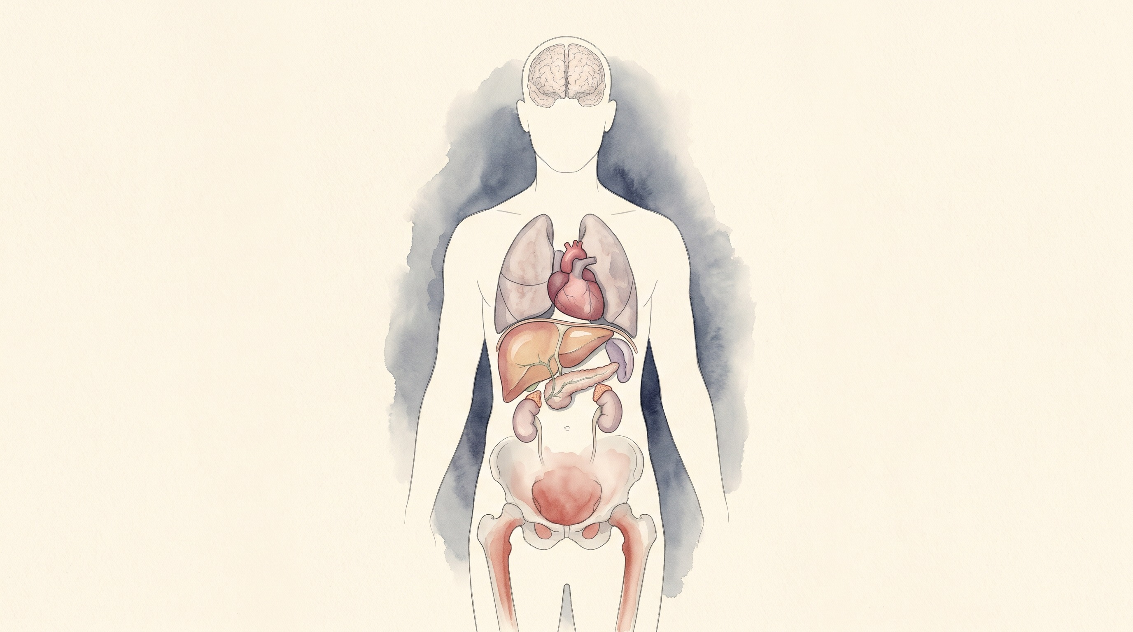
Which other organs fail in ALF?
Brain
encephalopathy, cerebral edema
Lungs
ARDS
Heart and vessels
vasodilatory shock
Spleen and immune system
infection
Liver
hypoglycemia, lactate, INR
Adrenals
relative insufficiency
Kidneys
AKI
Pancreas
pancreatitis
Bone marrow
suppression
Figure content after Bernal W, Wendon J.
N Engl J Med 2013;369:2525-34
9/58
Notes:
This is why these patients are ICU patients. Hypoglycemia, lactic acidosis, vasodilatory shock, relative adrenal insufficiency, AKI, lung injury and a high risk of infection. The liver is one organ on this picture.

Slide 15
28F, 4 days of nausea
What's your next step?
10/58
Notes:
Wait for answers. Usually people list tests in order. That's the trap.

Slide 16
The first hour
Support | Workup
ICU bed Glucose every 1 to 2 hours Volume, perfusion, lactate Neuro checks | Acetaminophen level Viral, autoimmune, Wilson, toxicology Doppler ultrasound Pregnancy test
Send the workup while you resuscitate
11/58
Notes:
The classic mistake is a serial workup: wait for the hepatitis panel, then the autoimmune markers, then act. Support and workup run in parallel. Who else to call, and when, comes later in the talk.

Slide 17
Which cause changes treatment right away?
If you suspect | Clues | Send | Don't wait to
Acetaminophen | AST/ALT in the thousands, OTC use | Level, combination products
Herpes simplex | Fever, very high AST/ALT, little jaundice | HSV PCR (blood)
Hepatitis B | Endemic area, chemo or immunosuppression | HBsAg, anti-HBc IgM, DNA
Autoimmune hepatitis | Woman, other autoimmune disease | ANA, ASMA, IgG
Wilson disease | Under 40, Coombs-negative hemolysis | Ceruloplasmin, urine copper
AFLP, HELLP | Third trimester, high BP, low platelets | hCG
Budd-Chiari | Pain, ascites, big liver | Doppler or CT
Ischemic hepatitis | Shock or arrest, very high LDH | Echo
Amanita | Wild mushrooms, diarrhea 6-24 h later | Poison control
Update 2022 [PMID: 36001996]; practical update 2024 [PMID: 39170946]; EASL AIH 2025 [PMID: 40348684]
12/58
Notes:
Clues: acetaminophen gives the highest aminotransferases with a low bilirubin early. HSV is often anicteric with fever and leukopenia, and a rash is absent in about half. HBV reactivation follows chemotherapy, rituximab or steroids. Wilson: young, Coombs-negative hemolysis, ALP disproportionately low (ALP to bilirubin ratio under 4), AST to ALT over 2.2. Ischemic hepatitis peaks early with a very high LDH and falls fast once the circulation is fixed. The point of the workup in the ICU is the column on the right. Some of these you start empirically before the test comes back: NAC, acyclovir. Negative autoimmune serologies do not exclude acute AIH. Wilson disease presenting as ALF basically means transplant.

Slide 18
Which cause changes treatment right away?
If you suspect | Clues | Send | Don't wait to
Acetaminophen | AST/ALT in the thousands, OTC use | Level, combination products | Start NAC
Herpes simplex | Fever, very high AST/ALT, little jaundice | HSV PCR (blood) | Start IV acyclovir
Hepatitis B | Endemic area, chemo or immunosuppression | HBsAg, anti-HBc IgM, DNA | Entecavir or tenofovir
Autoimmune hepatitis | Woman, other autoimmune disease | ANA, ASMA, IgG | Steroids with hepatology
Wilson disease | Under 40, Coombs-negative hemolysis | Ceruloplasmin, urine copper | Urgent transplant
AFLP, HELLP | Third trimester, high BP, low platelets | hCG | Obstetrics: delivery
Budd-Chiari | Pain, ascites, big liver | Doppler or CT | Anticoagulate; TIPS
Ischemic hepatitis | Shock or arrest, very high LDH | Echo | Fix the circulation
Amanita | Wild mushrooms, diarrhea 6-24 h later | Poison control | NAC, silibinin
Update 2022 [PMID: 36001996]; practical update 2024 [PMID: 39170946]; EASL AIH 2025 [PMID: 40348684]
12/58
Notes:
Clues: acetaminophen gives the highest aminotransferases with a low bilirubin early. HSV is often anicteric with fever and leukopenia, and a rash is absent in about half. HBV reactivation follows chemotherapy, rituximab or steroids. Wilson: young, Coombs-negative hemolysis, ALP disproportionately low (ALP to bilirubin ratio under 4), AST to ALT over 2.2. Ischemic hepatitis peaks early with a very high LDH and falls fast once the circulation is fixed. The point of the workup in the ICU is the column on the right. Some of these you start empirically before the test comes back: NAC, acyclovir. Negative autoimmune serologies do not exclude acute AIH. Wilson disease presenting as ALF basically means transplant.

Slide 19
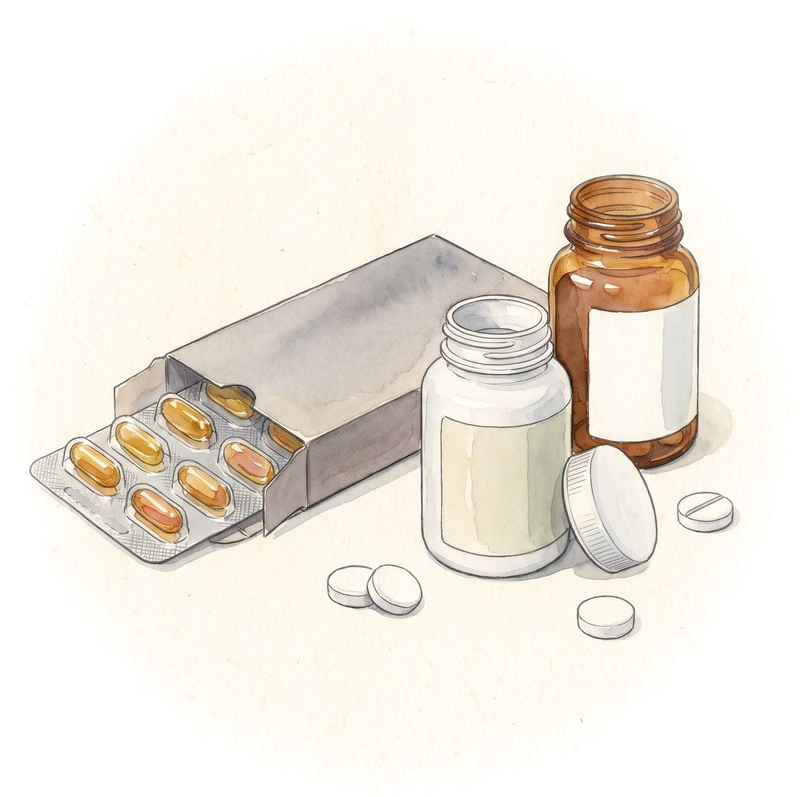
28F, 4 days of nausea
Roommate: "She was taking a lot of the Tylenol with codeine, plus cold medicine, for 3 days"
Acetaminophen level: 12 μg/mL, time of last dose unknown
Can you use the nomogram?
13/58
Notes:
Combination products are where the hidden acetaminophen is. Ask about every over-the-counter product by name.

Slide 20
28F, 4 days of nausea
Roommate: "She was taking a lot of the Tylenol with codeine, plus cold medicine, for 3 days"
Acetaminophen level: 12 μg/mL, time of last dose unknown
Can you use the nomogram?
No. Rumack-Matthew is for a single acute ingestion with a known time
Repeated supratherapeutic use and late presentation: the level can be low or undetectable
Start NAC now
13/58
Notes:
An undetectable or low level late in the course does not exclude acetaminophen toxicity [PMID: 36001996]. NAC is safe enough that the threshold to start it is low. Dosing per your pharmacy protocol.

Slide 21
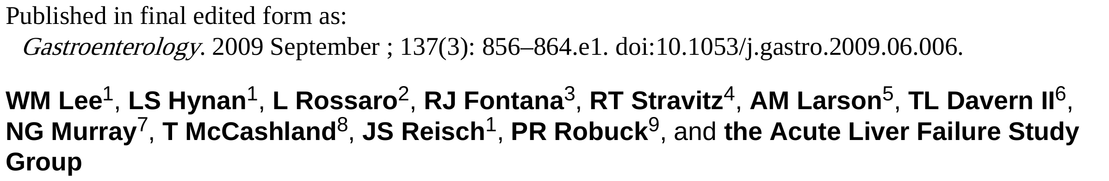
NAC for every kind of acute liver failure?
What do you think they found?
Lee WM et al. Gastroenterology 2009;137:856-64 [PMID: 19524577]
14/58

Slide 22
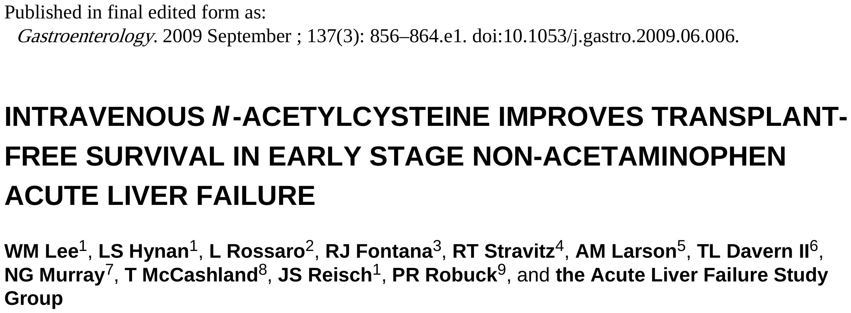
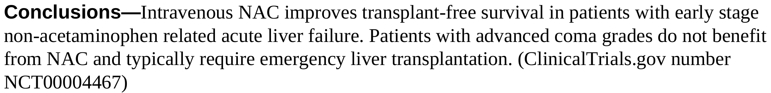
NAC for every kind of acute liver failure?
Lee WM et al. Gastroenterology 2009;137:856-64 [PMID: 19524577]
14/58
Notes:
The ALFSG trial: 173 adults with non-acetaminophen ALF, NAC or placebo for 72 hours, 24 US centers. Read their conclusion, then the numbers.

Slide 23
NAC for every kind of acute liver failure?
Adult non-acetaminophen ALF, randomized, NAC vs placebo, 173 patients
Reasonable in early non-acetaminophen ALF. Don't extrapolate to advanced coma, children or ACLF
Lee WM et al. Gastroenterology 2009 [PMID: 19524577]
15/58
Notes:
Overall survival at 3 weeks was not different. The transplant-free survival benefit was in coma grade I-II, which is a subgroup. That doesn't support NAC in advanced non-acetaminophen ALF or in ACLF. ACG 2023 suggests NAC in non-acetaminophen ALF; this trial is why the early-coma patients are the ones most likely to benefit. And don't carry the grade III-IV result over to Patient A: in acetaminophen ALF, NAC continues when she gets worse.

Slide 24
28F, 4 days of nausea
 | Admission | Hour 12
Mental status | Disoriented, asterixis | Responds only to voice (grade III)
Ammonia (arterial) | Not sent | 182 μmol/L
Urine output | OK | 15 mL/h for 4 hours
Lactate (after 3 L) | 2.1 mmol/L | 4.6 mmol/L
Creatinine | 1.0 mg/dL | 1.3 mg/dL
Sodium | 136 mmol/L | 133 mmol/L
Glucose | 54 mg/dL | Needs D10
What worries you most?
16/58
Notes:
Hour 12. Hepatology has seen her and the transplant evaluation is under way. Let them pick. Kidney? Lactate? The answer for a hyperacute patient with this ammonia is the brain.

Slide 25
28F, 4 days of nausea
 | Admission | Hour 12
Mental status | Disoriented, asterixis | Responds only to voice (grade III)
Ammonia (arterial) | Not sent | 182 μmol/L
Urine output | OK | 15 mL/h for 4 hours
Lactate (after 3 L) | 2.1 mmol/L | 4.6 mmol/L
Creatinine | 1.0 mg/dL | 1.3 mg/dL
Sodium | 136 mmol/L | 133 mmol/L
Glucose | 54 mg/dL | Needs D10
Her brain
When do you intubate? Do you wait for the creatinine before dialysis?
16/58
Notes:
Two decisions we own as intensivists. Before answering, why is the brain the problem?

Slide 26
Why does the brain swell?
Liver can't clear ammonia
Astrocytes take up ammonia
Ammonia + glutamate → glutamine
Intracranial hypertension, herniation
Astrocyte swelling, cerebral edema
Glutamine pulls in water, mitochondria fail
Makes it worse: inflammation and infection, loss of autoregulation, fever, low sodium
Highest risk: hyperacute course, young, grade III-IV encephalopathy, ammonia persistently above 150 to 200 μmol/L, AKI, vasopressors
Update 2022 [PMID: 36001996]; practical update 2024 [PMID: 39170946]
17/58
Notes:
This is why ammonia is actionable in ALF. The brain has no time to adapt, unlike in cirrhosis where astrocytes compensate over months. Every element of the bundle that follows maps to a box on this slide.

Slide 27

Ammonia: ALF vs cirrhosis
Why do patients with cirrhosis rarely get cerebral edema, even with a high ammonia?
18/58

Slide 28
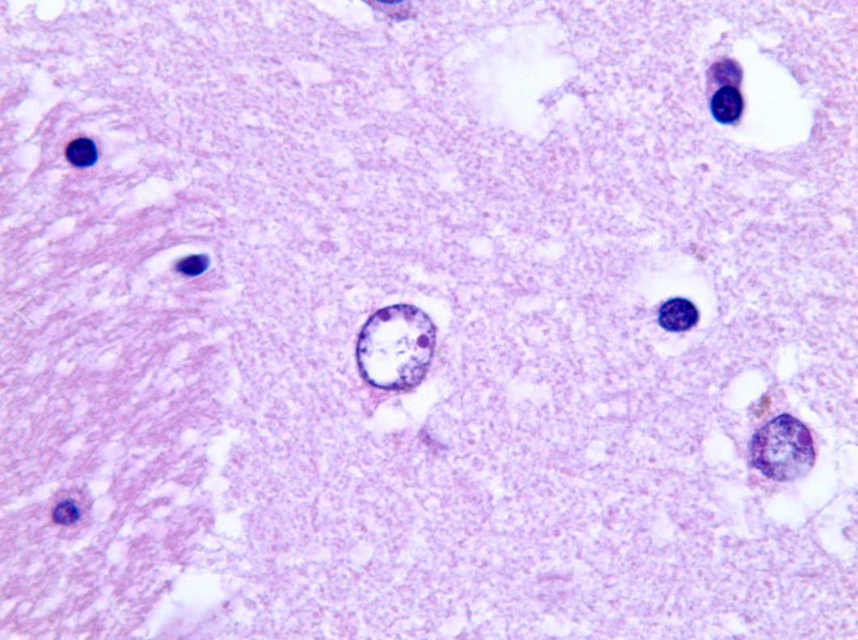
Ammonia: ALF vs cirrhosis
Astrocytes clear ammonia by turning it and glutamate into glutamine
Glutamine pulls water into the cell
Cirrhosis: over months the astrocyte pushes out other solutes (myo-inositol, taurine) to make room. It swells only a little. This is the cell you see under the microscope
ALF: the ammonia comes in days. No time to adapt, so the astrocytes swell and the brain swells with them
Alzheimer type II astrocyte: big, pale nucleus
Normal glial nucleus: small and dark
Cerebral edema is common in hyperacute ALF and rare in cirrhosis
18/58
Notes:
Alzheimer type II astrocytes are a sign of chronic hyperammonemia: cirrhosis, Wilson disease, urea cycle defects. They show adaptation. In hyperacute ALF the astrocytes don't get the time, which is why the young acetaminophen patient herniates at an ammonia a cirrhotic would tolerate. Point at the big pale nucleus in the middle, then the small dark normal nuclei.

Slide 29
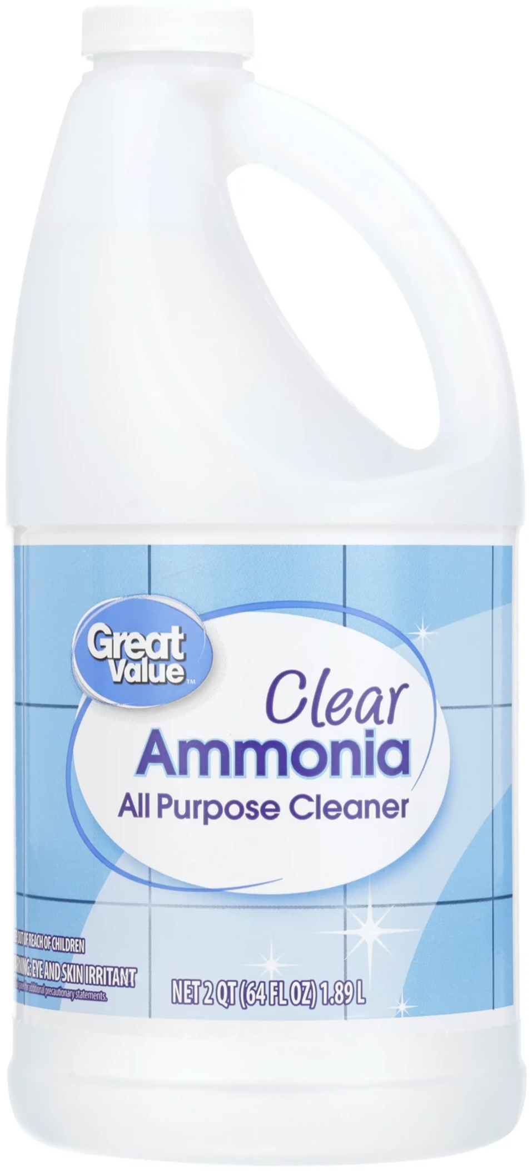
Ammonia: how high is too high?
So what number worries you?
Clemmesen JO et al. Hepatology 1999 [PMID: 10051463]; Kumar R et al. Clin Gastroenterol Hepatol 2012 [PMID: 22521861]; more studies in the appendix
19/58
Notes:
Left: in Copenhagen, ammonia was drawn at the onset of grade III encephalopathy. The 14 patients who herniated had about twice the arterial ammonia of those who didn't, and all of them were above 146. Right: in Delhi, ammonia that stayed at or above 122 for three days went with a third of the survival and twice the cerebral edema of ammonia that came down. These are associations, not proof that lowering the number saves the patient, but they are why we trend it. In Bernal's King's cohort, more than 200 meant intracranial hypertension in 55%, yet most patients who developed ICH were below 200. Practical point: whatever you send, put it on ice and get it run quickly. A delayed sample reads falsely high. In cirrhosis, a single ammonia doesn't diagnose HE and shouldn't be trended to dose lactulose.

Slide 30
Ammonia: how high is too high?
146
Above 150 to 200 and not falling: worry about the brain
No single level rules ICH in or out. Read it with the HE grade and the trend
Clemmesen JO et al. Hepatology 1999 [PMID: 10051463]; Kumar R et al. Clin Gastroenterol Hepatol 2012 [PMID: 22521861]; more studies in the appendix
19/58
Notes:
Left: in Copenhagen, ammonia was drawn at the onset of grade III encephalopathy. The 14 patients who herniated had about twice the arterial ammonia of those who didn't, and all of them were above 146. Right: in Delhi, ammonia that stayed at or above 122 for three days went with a third of the survival and twice the cerebral edema of ammonia that came down. These are associations, not proof that lowering the number saves the patient, but they are why we trend it. In Bernal's King's cohort, more than 200 meant intracranial hypertension in 55%, yet most patients who developed ICH were below 200. Practical point: whatever you send, put it on ice and get it run quickly. A delayed sample reads falsely high. In cirrhosis, a single ammonia doesn't diagnose HE and shouldn't be trended to dose lactulose.

Slide 31
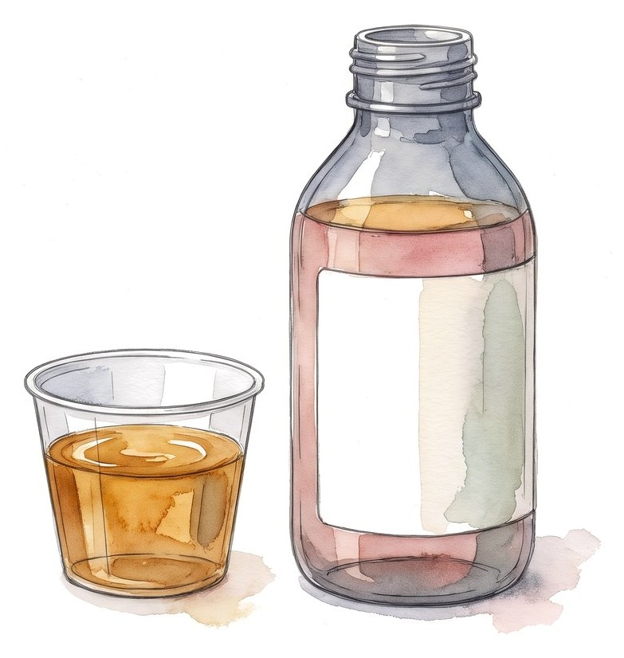
Lactulose for her?
Hour 12: ammonia 182 μmol/L, grade III. In a cirrhotic we'd already be giving it
Yes or no?
20/58

Slide 32
Lactulose for her?
Hour 12: ammonia 182 μmol/L, grade III. In a cirrhotic we'd already be giving it
Why people give it | Why not
Ammonia drives brain swelling | No proven benefit in ALF (ALFSG)
It's what we do in cirrhosis | Distended bowel gets in the way at transplant
Cheap; AASLD 2011 allowed it early | Diarrhea: free water loss, sodium swings
 | Liquid by mouth or tube: aspiration risk
Not for her
AASLD position paper 2011, rec. 26; Alba L, Hay JE, Lee WM et al. J Hepatol 2002;36(Suppl 1):33 (abstract); ACG ALF 2023 [PMID: 37377263]
20/58
Notes:
The ALF Study Group data were a retrospective comparison presented only as an abstract: a small increase in survival time with lactulose, no difference in encephalopathy grade or overall outcome. The 2011 AASLD position paper allowed lactulose in early encephalopathy, orally or rectally, but not to the point of diarrhea, and warned about bowel distension during transplant. Neither the 2023 ACG guideline nor EASL 2017 recommends it. What actually lowers her ammonia comes in a few slides; don't give it away here. In ACLF it's the opposite: lactulose is first-line for overt HE.

Slide 33
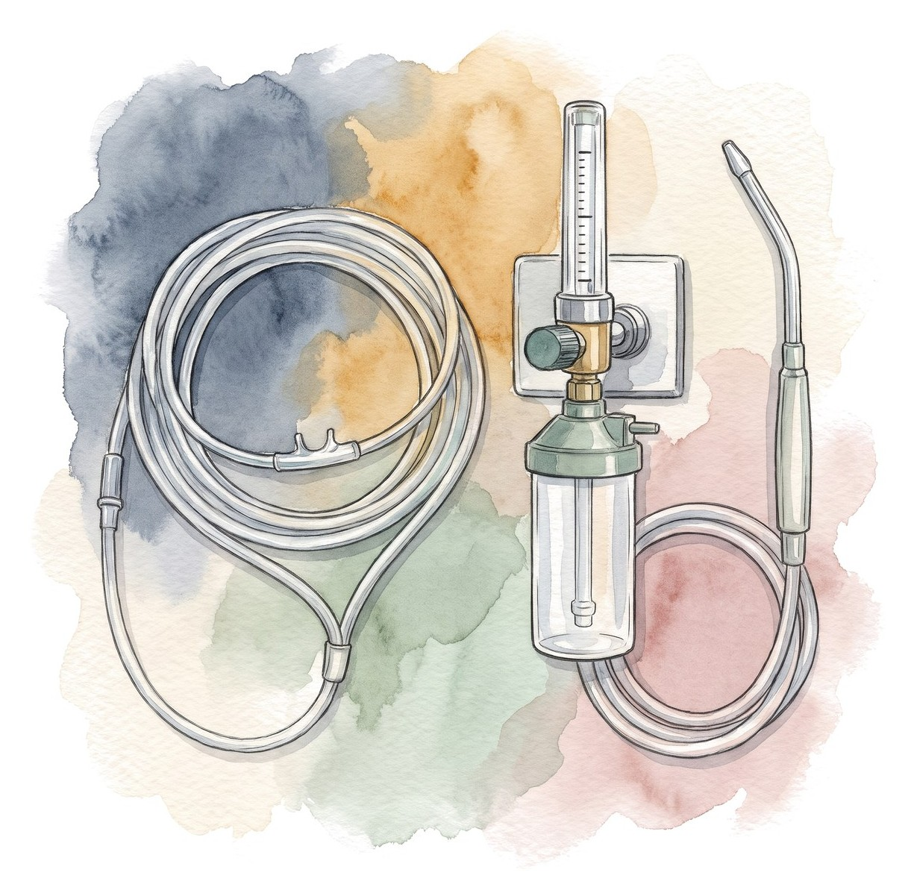
When do you intubate?
Responds to voice, drifts off, intermittently agitated
Handling secretions for now
SpO2 96% on 2 L
Intubate now, or wait until she can't protect her airway?
21/58
Notes:
I'd intubate her now. Most fellows want to wait. In ALF the progression from grade II to grade IV can be fast, and an emergency intubation in a coagulopathic, hypotensive patient with a swollen brain is the worst version of this procedure.

Slide 34
When do you intubate?
Grade III-IV encephalopathy in ALF: intubate
Before | During | After
Preoxygenate Norepinephrine ready Check glucose Head of bed 30°, neck neutral | Avoid hypotension (CPP) No coughing or bucking (ICP) Most experienced operator | Propofol: short-acting, may lower ICP Avoid long-acting benzodiazepines Check pupils: sedation hides the exam
Practical update 2024 [PMID: 39170946]; ACG ALF 2023 [PMID: 37377263]; SCCM 2020 [PMID: 32058387]
21/58
Notes:
The goals are airway protection, controlled ventilation, and no swings in blood pressure or CO2. Peri-intubation hypotension drops cerebral perfusion pressure; coughing raises ICP. Plan it like a neuro intubation.

Slide 35
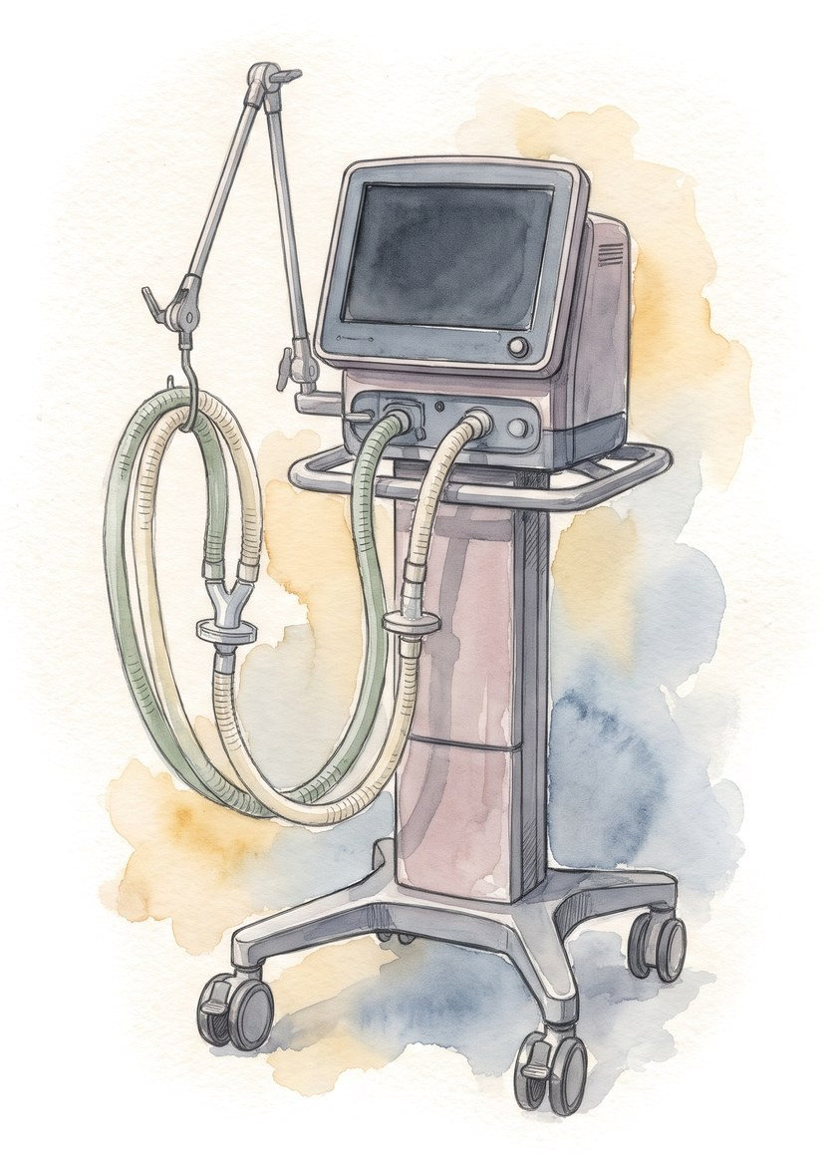
Can we use permissive hypercapnia?
After intubation: bilateral infiltrates, P/F 150 on PEEP 10
Lung protection or brain protection?
22/58
Notes:
This is the PCCM-specific tradeoff. ARDS teaching says accept hypercapnia. Neuro teaching says don't.

Slide 36
Can we use permissive hypercapnia?
After intubation: bilateral infiltrates, P/F 150 on PEEP 10
 | For the lungs (ARDS) | For the brain (ICP) | What we do
Tidal volume | 6 mL/kg PBW | Watch the CO2 | 6 mL/kg, raise the rate
CO2 | Tolerate a high CO2 | High CO2 raises ICP | Keep the CO2 normal
Hyperventilation | No | Lowers ICP briefly | Short rescue for herniation only
PEEP | Recruit | High PEEP: less venous return | Set for O2 and BP; PEEP is fine
SCCM 2020 [PMID: 32058387]; practical update 2024 [PMID: 39170946]
22/58
Notes:
Low tidal volume still applies. What changes is the CO2 target. Prophylactic hyperventilation is out; brief hyperventilation as a bridge in impending herniation is a different thing.

Slide 37
CO2 and cerebral blood flow
Aim here
Between about 20 and 80 mmHg, cerebral blood flow rises with PaCO2
In a swollen brain, more blood volume means a higher ICP
Keep PaCO2 normal. Hyperventilate only as a short bridge for herniation
Hyperventilation: less flow, lower ICP for a short time; too much can cause ischemia
Cerebral blood flow
Permissive hypercapnia: more flow, more blood volume, higher ICP
20
40
60
80
100
PaCO2 (mmHg)
Schematic, not to scale. Standard cerebral physiology
23/58
Notes:
Draw this on the board if you don't have the slide. It's the reason the ARDS habit of tolerating a high CO2 doesn't carry over to a patient with grade III-IV encephalopathy and a high ammonia.

Slide 38
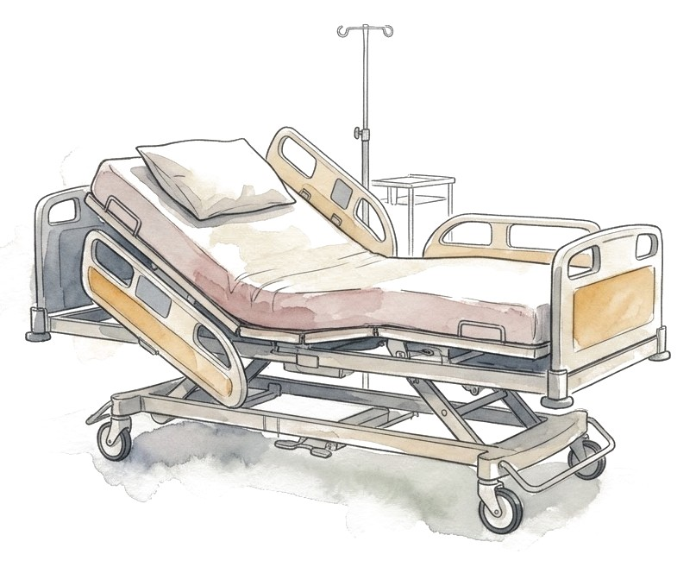
Protecting the brain: every patient with grade III-IV
Head of bed 30°, neck neutral
Treat fever, avoid hypoglycemia
Sodium 145 to 155 mmol/L with hypertonic saline (use your center's protocol)
Avoid fluid overload
Treat seizures, EEG if in doubt. No routine prophylaxis
No cooling: 34 °C did not prevent intracranial hypertension in an RCT
SCCM 2023 [PMID: 37052436]; update 2022 [PMID: 36001996]; Bernal W et al. J Hepatol 2016;65:273-9
24/58
Notes:
Sodium targets differ between sources: the 2022 update uses 145 to 155 for prevention, the 2024 practical review a lower range. Agree on one with transplant hepatology and write it in the orders. Hypertonic saline is a conditional SCCM recommendation for patients at risk of intracranial hypertension. The cooling trial randomized intubated high-risk ALF patients to 34 vs 36 °C for 72 hours; no difference in intracranial hypertension or survival. Avoid fever, don't induce hypothermia.

Slide 39
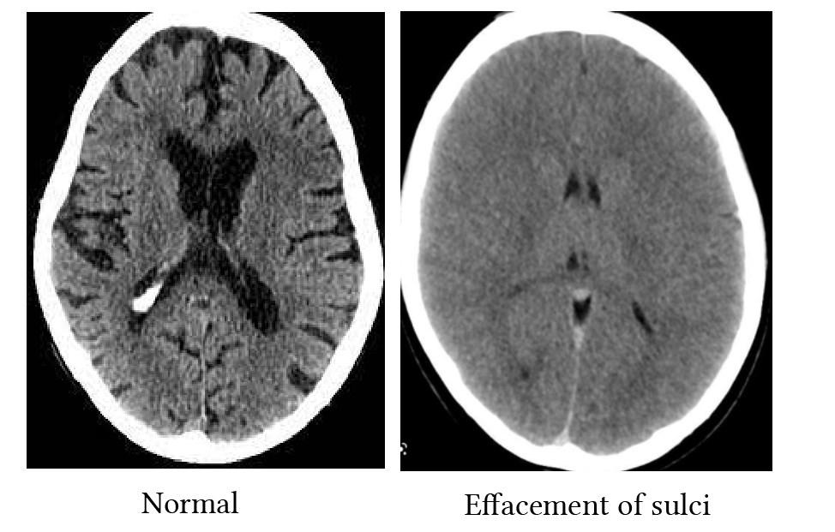
Rising ICP: hypertension, bradycardia, a new pupil
Hyperosmolar bolus (hypertonic saline or mannitol)
Brief hyperventilation as a bridge
Call the transplant team now
Things to know
Hypertension and bradycardia come late. Don't wait for them
A normal head CT does not exclude raised ICP
ICP monitors are not routine; SCCM suggests against (very low certainty)
SCCM 2023 [PMID: 37052436]; practical update 2024 [PMID: 39170946]
25/58
Notes:
A new pupil asymmetry or a sudden change in the exam is enough to act. Treat first, then image if a bleed or another structural lesion is possible.

Slide 40
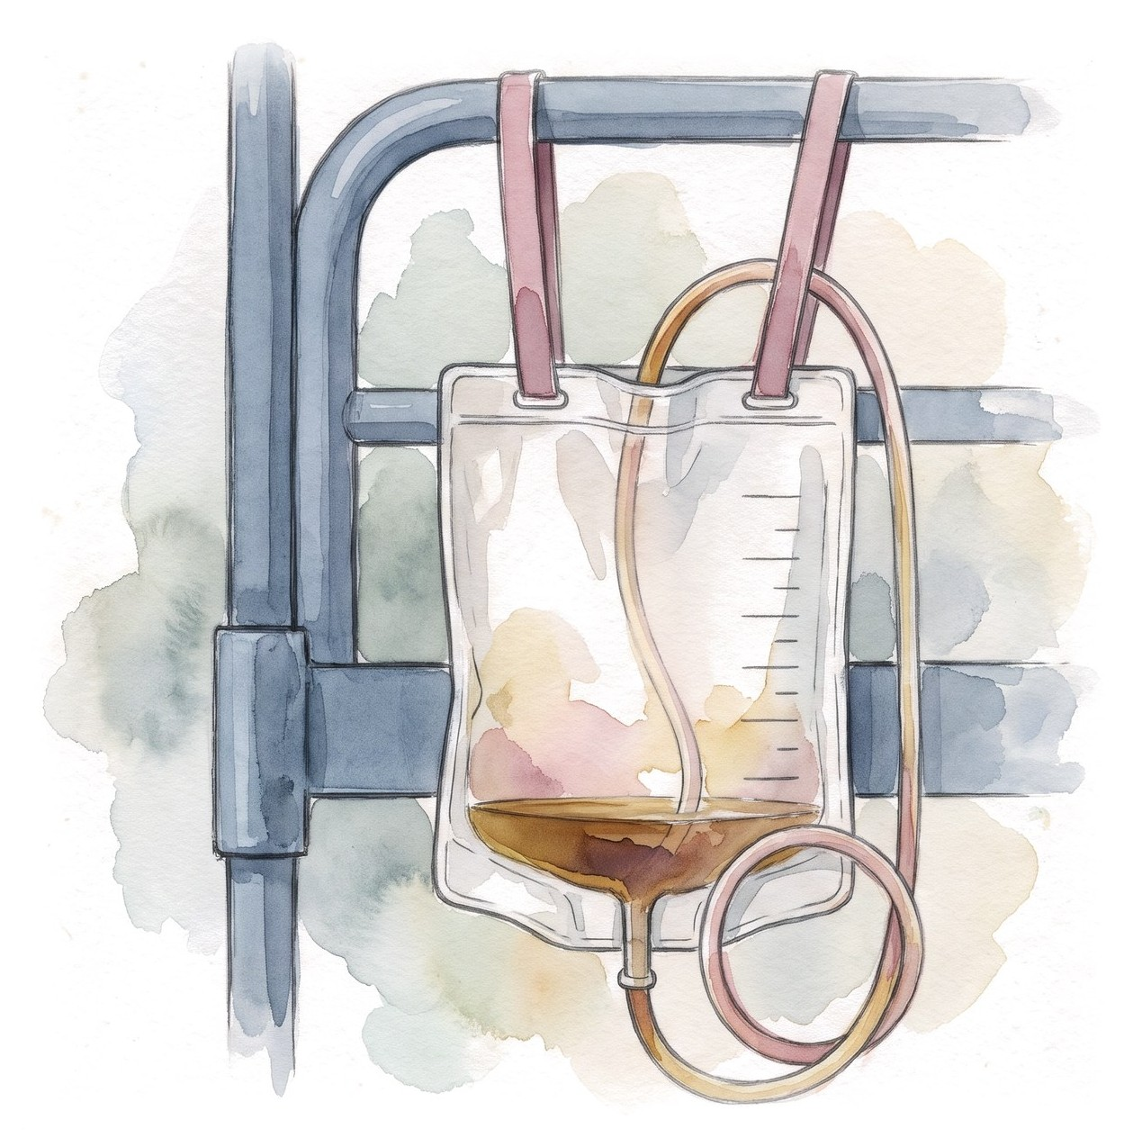
The creatinine is only 1.3
Ammonia 182 → 214 μmol/L, grade III, urine output 15 mL/h
Do you wait for a conventional dialysis indication?
26/58
Notes:
Ask them. Nephrology will often say the creatinine doesn't meet criteria. That's the wrong frame for ALF.

Slide 41
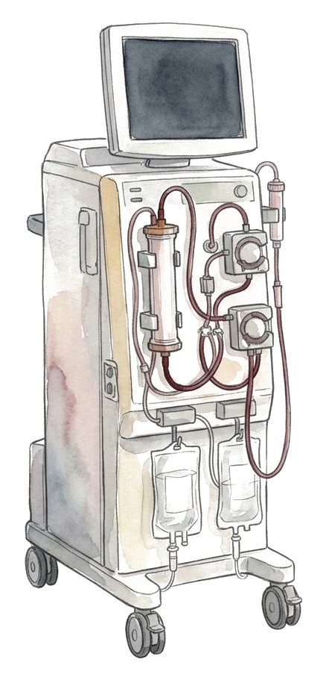
The creatinine is only 1.3
Ammonia 182 → 214 μmol/L, grade III, urine output 15 mL/h
No. In ALF, start CRRT for the ammonia
ACG 2023: suggests early CRRT for hyperammonemia with grade II or higher encephalopathy, even without a renal indication (conditional, very low certainty)
Continuous, not intermittent: fewer swings in blood pressure and brain water
Call nephrology now
ACG ALF guideline 2023 [PMID: 37377263]; update 2022 [PMID: 36001996]
26/58
Notes:
Ammonia around 150 to 200 is a high-risk context in the literature, not a universal threshold. Look at the trajectory and the neuro exam. Coordinate the CRRT fluid with the sodium plan or the dialysis will pull her sodium back down.

Slide 42
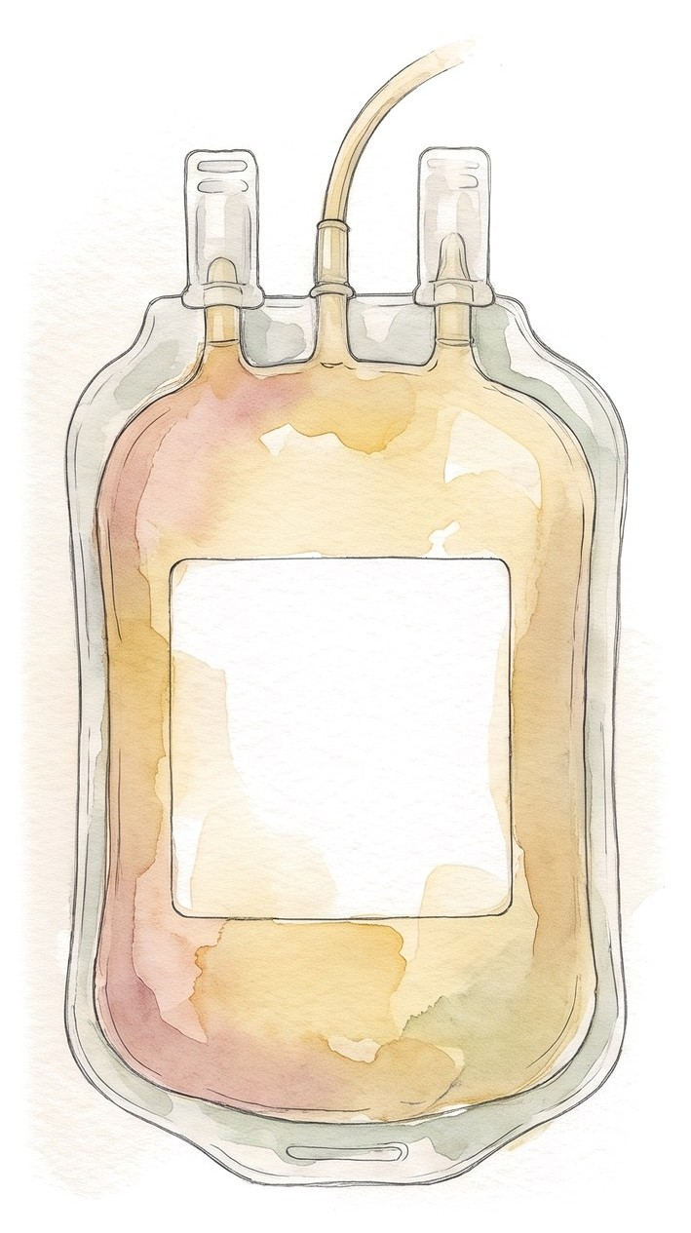
Should we correct this INR?
Hour 12: INR 4.1, platelets 88,000. She needs a dialysis catheter
2 units of FFP first?
27/58
Notes:
Hour 12, CRRT is starting. Very common request from the procedure side.

Slide 43
Should we correct this INR?
Hour 12: INR 4.1, platelets 88,000. She needs a dialysis catheter
No plasma just to fix the number
The INR measures only part of clotting, and in ALF it doesn't predict who bleeds
Plasma adds volume (lungs, brain) and erases the INR trend that prognosis and listing rely on
What to do instead
Ultrasound-guided line, experienced operator, compressible site
Vitamin K once; check fibrinogen and platelets; viscoelastic testing if available
Treat bleeding. Plan high-risk procedures (like an ICP monitor) separately
Update 2022 [PMID: 36001996]; SCCM 2020 [PMID: 32058387]
27/58
Notes:
The INR is a great marker of liver function and a poor marker of bleeding risk in ALF. Spontaneous bleeding is uncommon. Ask transplant hepatology before giving plasma: they need the native INR.

Slide 44
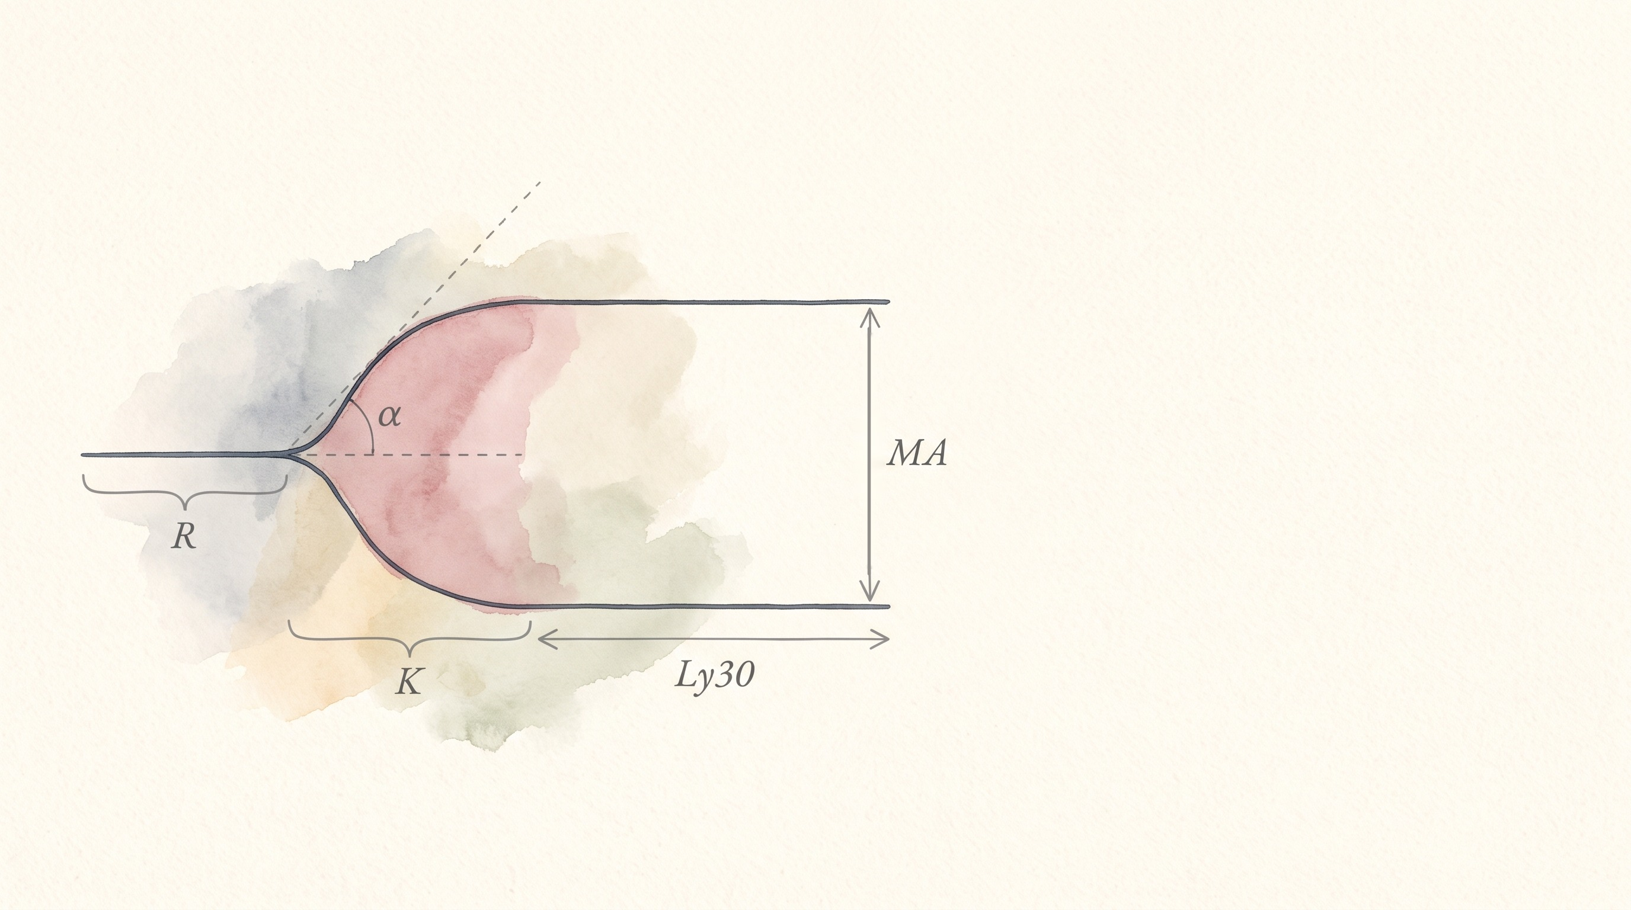
Is her blood thin?
What a TEG measures in whole blood
R: time until the clot starts (clotting factors)
K and α-angle: how fast the clot builds (fibrinogen)
MA: how strong the clot gets (platelets, fibrinogen)
Ly30: how much of the clot breaks down in 30 minutes
Her INR is 4.1. What will her TEG show?
28/58

Slide 45
Is her blood thin?
Most had a completely normal TEG, even with INRs up to 9.6
A weak clot (low MA) only when platelets were below about 126,000
Encephalopathy: stronger clots, not weaker
A high INR doesn't mean she will bleed
Stravitz RT et al. J Hepatol 2012;56:129-36 [PMID: 21703173]
28/58
Notes:
Answer to the question: in most patients, normal. 51 patients with acute liver injury (INR at least 1.5) or ALF (the same plus encephalopathy), mean INR 3.4, range 1.5 to 9.6. 32 of 51 (63%) had all five TEG parameters normal; 8 had one abnormal in the hypocoagulable direction, 5 had two, 4 had three, 2 had four. 4 patients (8%) had parameters in the hypercoagulable range. Lysis at 30 minutes was normal in all 51. Factors V and VII were low, but protein C, protein S and antithrombin fell too, and factor VIII was about 4 times normal. The INR measures only the procoagulant factors the liver makes; the liver also makes the anticoagulants, which fall just as far, and the endothelium pours out factor VIII and von Willebrand factor. The TEG sees the whole balance. That's why spontaneous bleeding is uncommon and why plasma before a line is not needed. Caveat: TEG is not validated to predict procedural bleeding, and a low platelet count or low fibrinogen still matters.

Slide 46
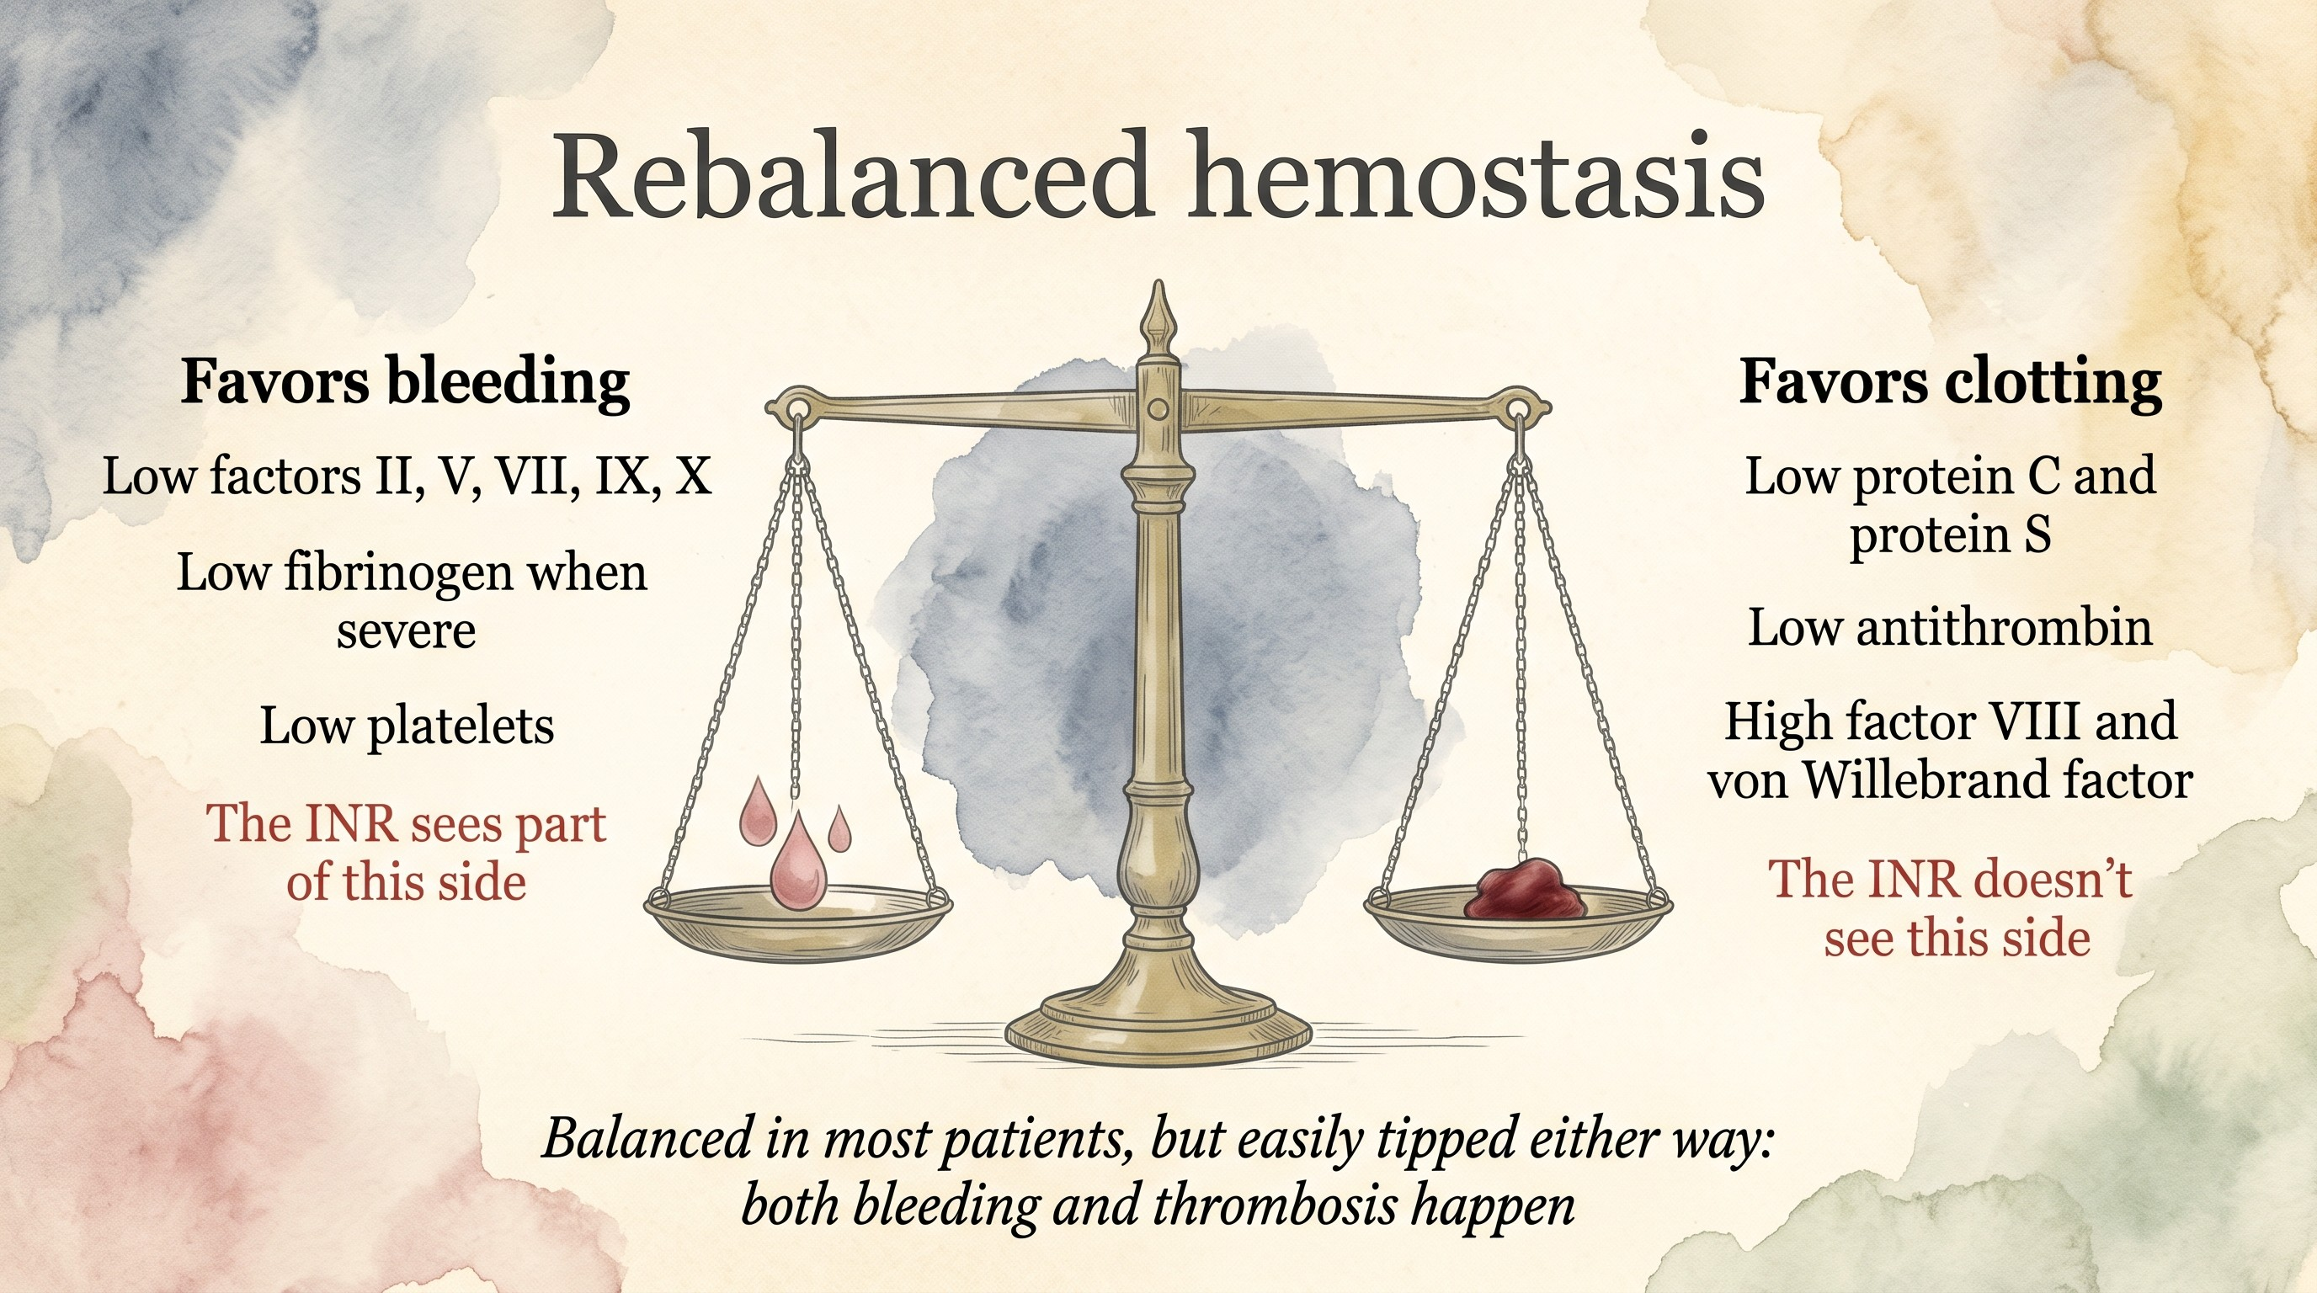
Concept from Lisman T, Porte RJ. Blood 2010
29/58
Notes:
Both sides go down together. The INR only tests the left pan, so it makes the patient look much more anticoagulated than she is. Viscoelastic tests look at clot formation in whole blood and in ALF are often close to normal despite a high INR, though they miss the endothelium and the protein C system too. The balance is fragile: infection, kidney failure and procedures tip it, and thrombosis, including line-related clots, is real.

Slide 47
Calling nephrology
What do you ask them for?
30/58

Slide 48
Calling nephrology
Indication: ammonia 214 and grade III encephalopathy. The creatinine doesn't matter here
Start now and keep it running. A clotted filter means the ammonia climbs back
One sodium plan: the CRRT fluid and the hypertonic saline together
Watch phosphate and potassium, and calcium if they use citrate
ACG ALF 2023 [PMID: 37377263]; update 2022 [PMID: 36001996]
30/58
Notes:
No universal dose or ammonia target to stop at; use your center's protocol. Where it usually goes wrong is the circuit: it keeps clotting, so the delivered clearance is a fraction of what was ordered. The other problem is a sodium plan that nobody owns. Citrate can build up in liver failure, so follow the total to ionized calcium ratio.

Slide 49
I know what you're thinking...
31/58
Notes:
Pause. Someone in the room has heard it from nephrology.

Slide 50
"CVVH doesn't clear ammonia"
True or false?
32/58

Slide 51

32/58
Notes:
Let the room enjoy it, then the details.

Slide 52
"CVVH doesn't clear ammonia"
Ammonia is tiny (17 Da), water soluble and not protein bound
It crosses the filter with the water (convection, CVVH) or down its gradient (diffusion, CVVHD)
What matters is the effluent dose and hours on a working circuit, more than the mode
More effluent, more clearance: 90 vs 35 mL/kg/h (Slack 2014)
54 ALF patients on CRRT: median ammonia 151 → 52 μmol/L by day 5 (Warrillow 2020)
It does. About half the clearance of urea, so dose and filter life matter
Fisher C et al. Blood Purif 2022 [PMID: 35042216]; Warrillow SJ et al. Crit Care Med 2020 [PMID: 31939790]; Slack AJ et al. Liver Int 2014
32/58
Notes:
You will hear this from nephrology. The physiology says otherwise: ammonia is a small, unbound, water-soluble molecule, and it moves across a high-flux filter with convection as well as diffusion. In Fisher's study of 12 patients with liver failure the three modalities gave similar ammonia clearance at the same effluent rate (no significant difference), and in the same patients urea clearance was about 50 mL/min and creatinine 42, so ammonia clears less well than urea but clearly clears. Why the doubt? The liver and the muscle keep making it, so the level falls slowly; a clotting circuit with a lot of downtime delivers much less than what was ordered; and at low effluent doses the effect is small. In Warrillow's cohort the fall tracked how long patients were on CRRT more than the hourly dose. Ask for a high effluent rate and an anticoagulation plan that keeps the filter running.

Slide 53
Does early CRRT actually help?
 | US ALF Study Group (2018) | Pilot RCT (2026)
Design | Registry, observational | Open label, ALF with cerebral edema
Comparison | CRRT vs no CRRT | CRRT within 12 h vs delayed
Finding
Catch
Cardoso FS et al. Hepatology 2018 [PMID: 28859230]; Aliment Pharmacol Ther 2026 [PMID: 42332991]
33/58
Notes:
The 2026 trial is interesting but don't oversell it. The early mortality signal is real in the abstract; 28-day survival by intention to treat was comparable, and the per-protocol analysis is biased by crossovers. Read the full methods before quoting more numbers.

Slide 54
Does early CRRT actually help?
 | US ALF Study Group (2018) | Pilot RCT (2026)
Design | Registry, observational | Open label, ALF with cerebral edema
Comparison | CRRT vs no CRRT | CRRT within 12 h vs delayed
Finding | Lower ammonia, better survival | Same 28-day survival; fewer deaths by day 7
Catch | Association; selection bias | Small, one center, protocol violations
Cardoso FS et al. Hepatology 2018 [PMID: 28859230]; Aliment Pharmacol Ther 2026 [PMID: 42332991]
33/58
Notes:
The 2026 trial is interesting but don't oversell it. The early mortality signal is real in the abstract; 28-day survival by intention to treat was comparable, and the per-protocol analysis is biased by crossovers. Read the full methods before quoting more numbers.

Slide 55
Day 3: the enzymes are falling
Is she getting better?
34/58
Notes:
Show only the enzymes. Most of the room will say yes.

Slide 56
Day 3: the enzymes are falling
Day 2 arterial pH 7.26 after fluids
No. The INR, the lactate and her brain are all worse
Made-up numbers for teaching
34/58
Notes:
Falling AST and ALT don't prove recovery. A rising INR, rising lactate and worse encephalopathy mean she is getting worse despite lower enzymes. One explanation is that there is little liver left to release them; shock and other causes also push the lactate up. Read the whole trajectory, not one line [PMID: 36001996]. Point out the day 2 arterial pH of 7.26 after fluids. It comes back on the King's College slide.

Slide 57

When do you call transplant hepatology?
When she meets King's College criteria?
When MELD is high enough?
35/58
Notes:
Let them vote.

Slide 58
When do you call transplant hepatology?
You should have called on admission, when you first suspected ALF
King's College criteria predict death without transplant. They are specific, not sensitive
They are not a referral threshold. If you wait for them, the evaluation starts too late
Patient A: arterial pH 7.26 on day 2 after fluids. She now meets the acetaminophen criteria
O'Grady 1989 criteria, as summarized in EASL 2017 [PMID: 28417882]; full criteria in the appendix
35/58
Notes:
King's College criteria are specific but not very sensitive. If you wait for them, the evaluation starts too late. Patient A now meets acetaminophen criteria by pH, but the call happened on admission. Transplant referral, listing and allocation are separate decisions; the transplant team handles the last two.

Slide 59
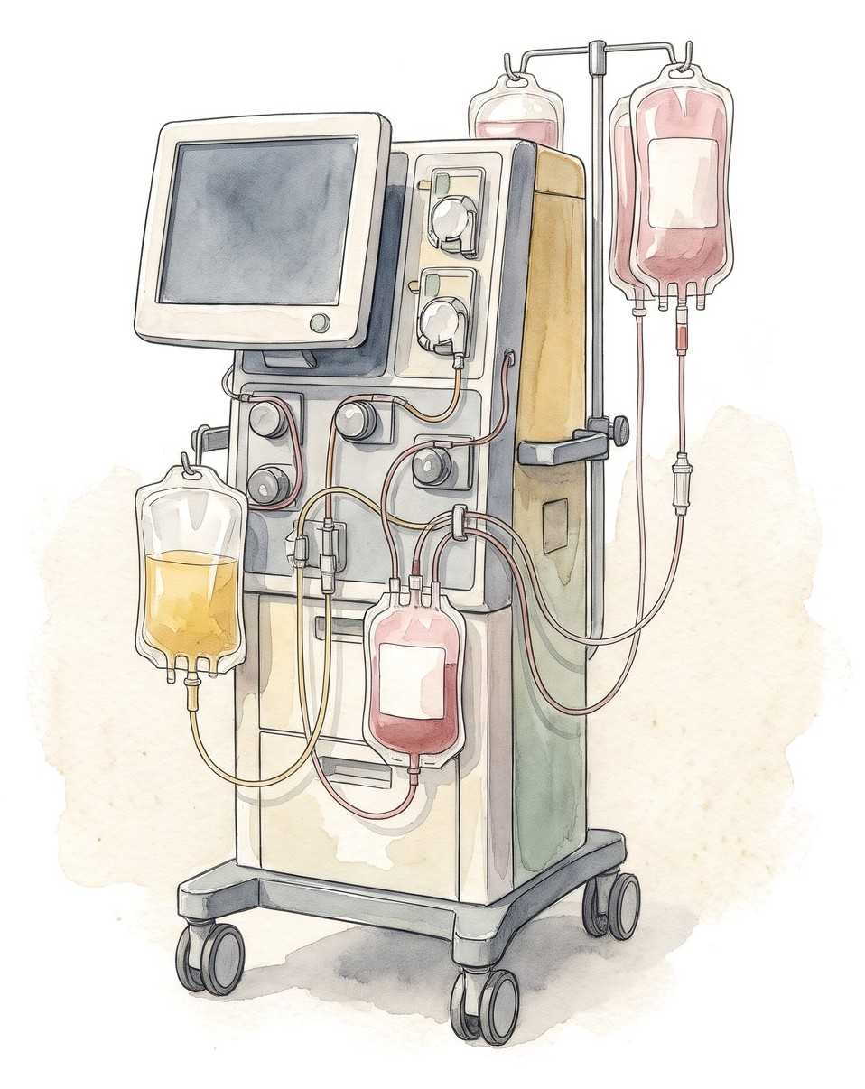
Does plasma exchange help in ALF?
 | Larsen 2016 | Burke 2025
Design | RCT, 182 ALF | UK, 7 centers, 378 ALF
Plasma exchange | High volume × 3 days | 120 patients, matched
Survival | 58.7% vs 47.8% (HR 0.56) | 51.4% vs 62.6% (p = 0.12)
Catch | Not blinded; no ACLF | Retrospective
Better blood pressure, no proven survival benefit
Larsen FS et al. J Hepatol 2016 [PMID: 26325537]; Burke L et al. J Hepatol 2025;82:615-21 [PMID: 39362282]
36/58
Notes:
Larsen: high-volume plasma exchange removes cytokines and DAMPs and replaces coagulation factors; hospital survival was better in the trial. Burke: all seven UK transplant centers, 2013 to 2021, propensity matched. Noradrenaline fell from 0.35 to 0.16 mcg/kg/min after plasma exchange, but overall survival (51.4% vs 62.6%) and transplant-free survival (42.6% vs 53.1%) were not better. Observational, so the sicker patients may have been the ones who got it. If you use it, use it early and as a bridge, and don't delay listing for it. The INR after plasma exchange is no longer the patient's INR, so tell transplant hepatology before the first session.

Slide 60
Bed 4 on day 3
Problem | What she's on | What we watch
Acetaminophen ALF, pH 7.26 | NAC; listed 1A on day 2 | Time to an offer
HE III-IV, ammonia 182 | Intubated, CO2 normal, Na 145-155, CRRT | Pupils, ammonia, Na
Lactate 5.8 and rising | Volume, MAP, look for infection | Lactate, MAP, pressors
INR 5.6, not bleeding | No plasma | Bleeding, INR trend
Infection risk | Surveillance cultures | Low bar for antimicrobials
Made-up numbers for teaching
37/58
Notes:
This is where she is while she waits. What would take her off the list: fixed dilated pupils, uncontrolled sepsis, rising support despite everything. If she becomes hypotensive: norepinephrine first, vasopressin next, hydrocortisone if refractory, and keep the MAP high enough for cerebral perfusion. Status 1A is the OPTN category for ALF in the ICU; check current policy before quoting details.

Slide 61

Any questions so far?
38/58

Slide 62
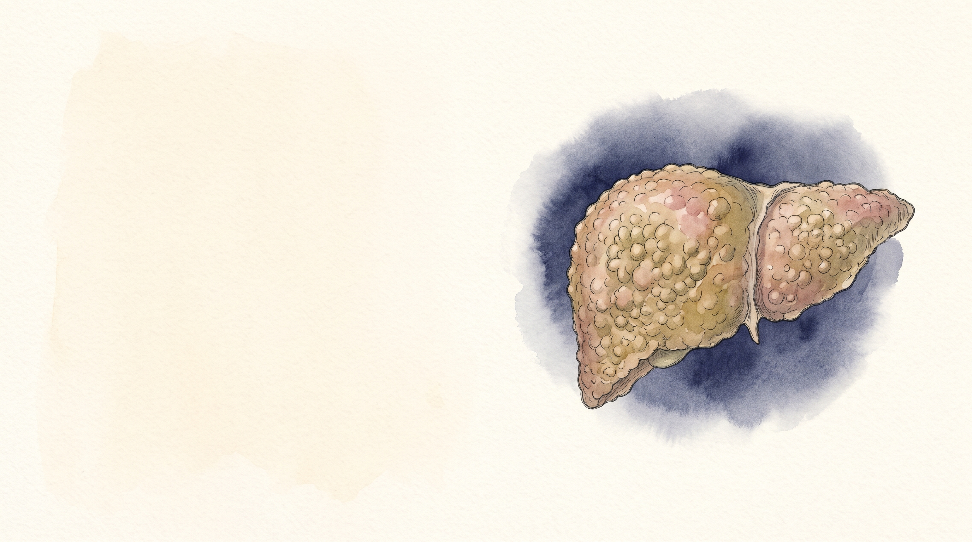
Bed 7
56M, cirrhosis and fever
39/58
Notes:
Second patient, in the unit at the same time.

Slide 63
56M, cirrhosis and fever
Alcohol-related cirrhosis, ascites on diuretics; last drink 3 weeks ago
Temp 38.4 °C, HR 112, BP 82/46
RR 26, SpO2 92% on a 35% Venturi mask; PaO2 74
Confused, asterixis (grade II)
Urine output 15 mL/h
 | Now | Baseline
Bilirubin (mg/dL) | 5.8 | 2.1
INR | 2.1 | 1.6
Creatinine (mg/dL) | 2.6 | 0.9
Sodium (mmol/L) | 127 | 133
WBC (/μL) | 16,200
Platelets (/μL) | 62,000
Lactate (mmol/L) | 3.9
What's your next step?
40/58
Notes:
Made-up patient. Same day, bed 7. After 2 L of fluid he is on norepinephrine 0.15 mcg/kg/min.

Slide 64
56M, cirrhosis and fever
Alcohol-related cirrhosis, ascites on diuretics; last drink 3 weeks ago
Temp 38.4 °C, HR 112, BP 82/46
RR 26, SpO2 92% on a 35% Venturi mask; PaO2 74
Confused, asterixis (grade II)
Urine output 15 mL/h
 | Now | Baseline
Bilirubin (mg/dL) | 5.8 | 2.1
INR | 2.1 | 1.6
Creatinine (mg/dL) | 2.6 | 0.9
Sodium (mmol/L) | 127 | 133
WBC (/μL) | 16,200
Platelets (/μL) | 62,000
Lactate (mmol/L) | 3.9
What's your next step?
Find the source: cultures, antibiotics
40/58
Notes:
Same as bed 4: treat first, label later. We'll count organs once the antibiotics are in.

Slide 65
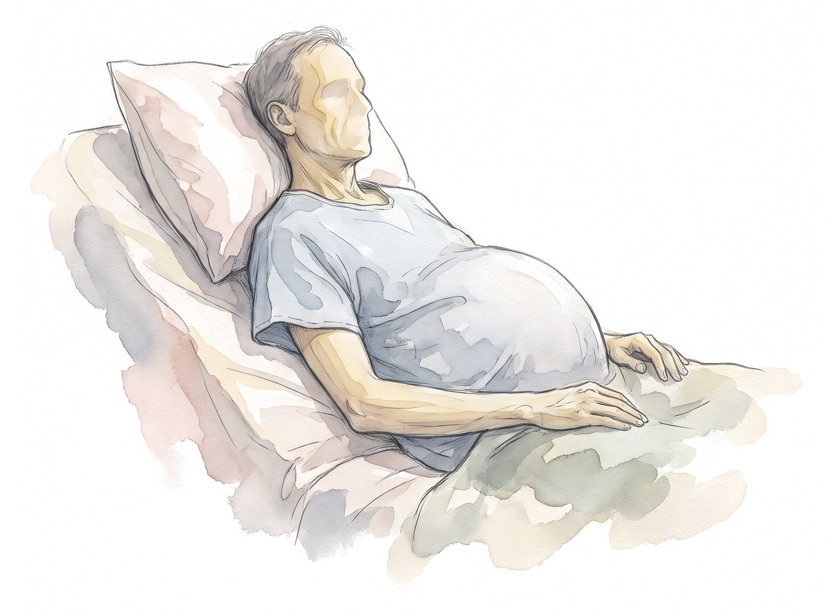
What tipped him over?
INR 2.1, platelets 62,000. Do you tap him?
41/58
Notes:
Ask what tipped him over before showing the answer. Then the procedural question: people hesitate to tap a coagulopathic patient.

Slide 66
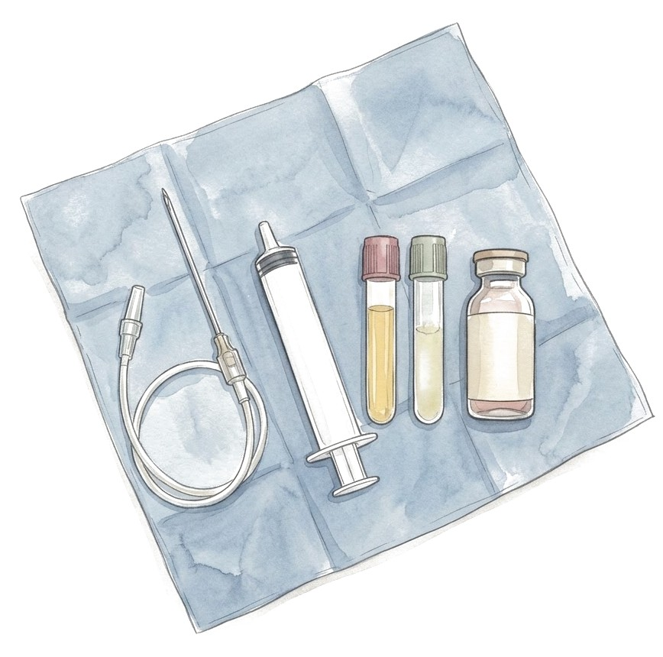
What tipped him over?
Yes, now. No plasma, no platelets
Ascitic fluid: PMN 1,240/mm³. Spontaneous bacterial peritonitis
Common triggers
Infection: SBP, pneumonia, urine, lines, C. difficile
Alcohol-associated hepatitis
GI bleeding
Drugs: NSAIDs, sedatives, too much diuretic
HBV flare, ischemia
No trigger is found in some patients. Repeat the search if he gets worse
EASL ACLF 2023 [PMID: 37364789]; SCCM 2023 [PMID: 37052436]
41/58
Notes:
Diagnostic paracentesis is low risk and should not wait for correction of the INR or platelets. Infection is the most common precipitant of ACLF in Western cohorts.

Slide 67
Why is he hypotensive?
42/58
Notes:
Let them list causes before you show the figure. Most will say sepsis and volume.

Slide 68
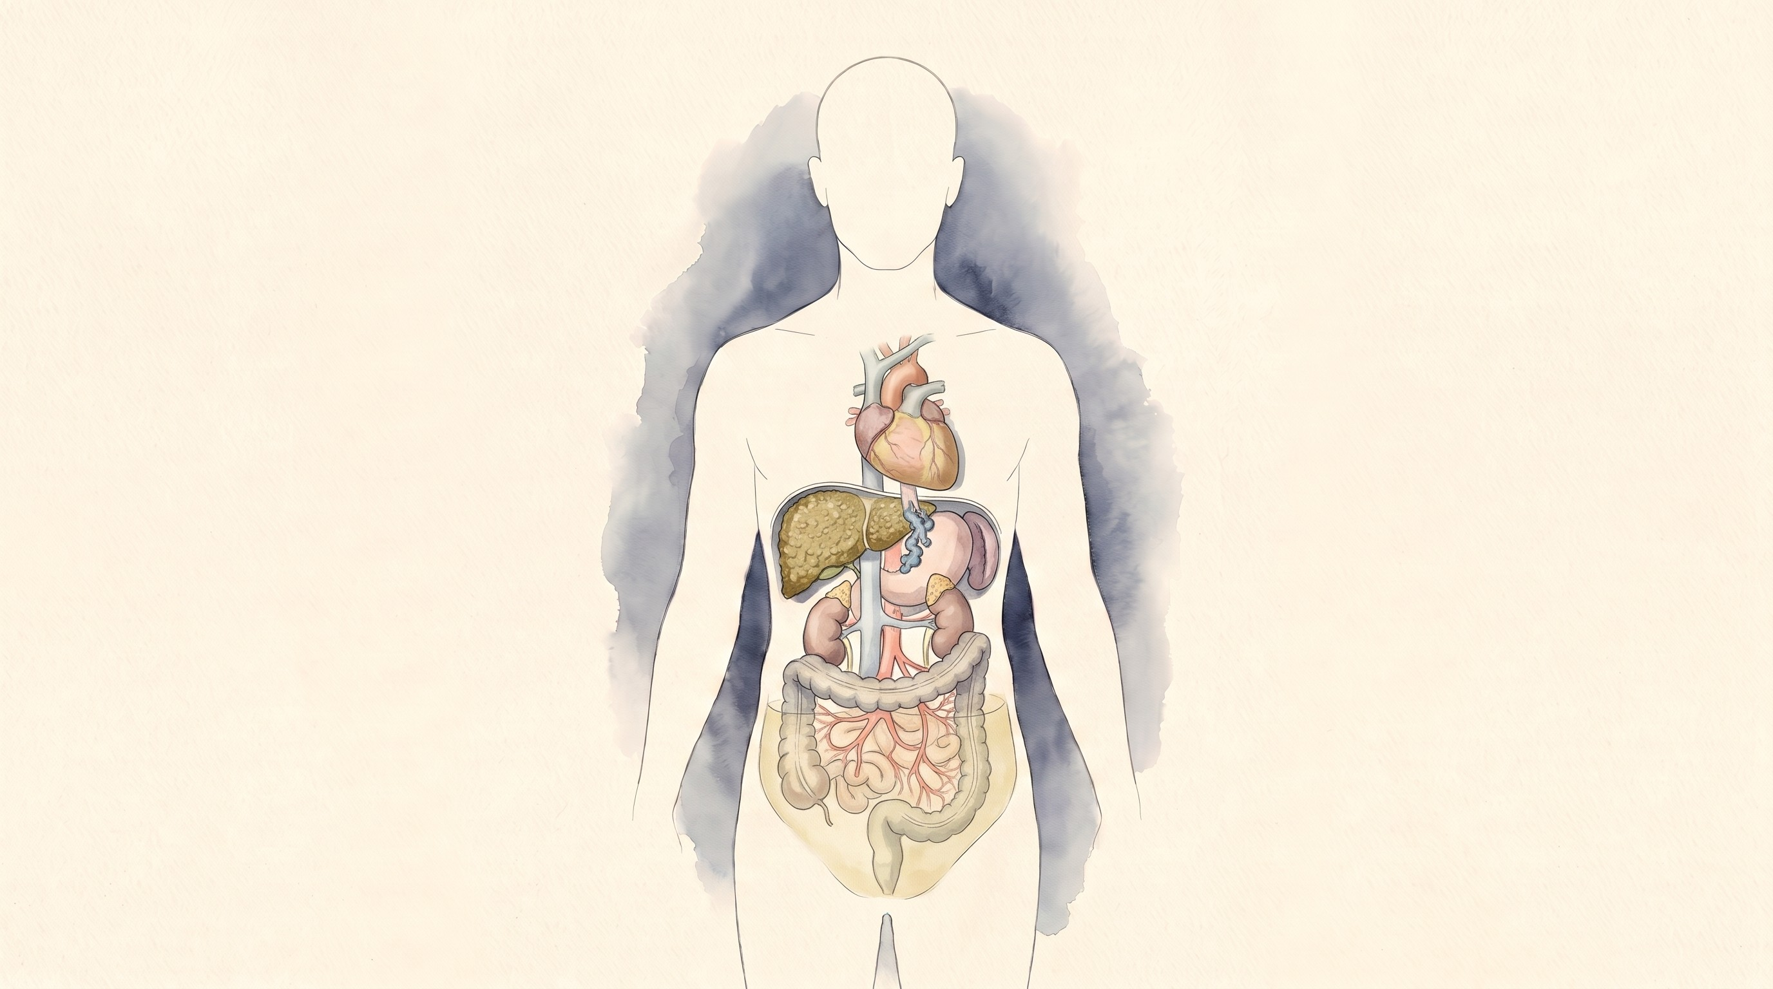
Why is he hypotensive?
Cirrhotic cardiomyopathy
Echo
Too little volume, or too much
Ultrasound and dynamic measures
Hidden bleeding
Hemoglobin, rectal exam, think varices
Relative adrenal insufficiency
Hydrocortisone if shock is refractory
Sepsis (SBP)
Cultures, antibiotics within 1 h, source control
Splanchnic vasodilation
Norepinephrine, MAP 65, adjust to perfusion
Usually more than one of these
42/58
Notes:
For SBP, cover for prior antibiotic exposure and local resistance. Albumin is a reasonable resuscitation fluid in cirrhosis, but every bag goes somewhere. Keep that in mind for the next few slides. Sources: Surviving Sepsis 2026 [PMID: 41869847]; SCCM 2020 [PMID: 32058387]; EASL ACLF 2023 [PMID: 37364789].

Slide 69
ALF, decompensation or ACLF?
 | Acute liver failure | Acute decompensation | ACLF
Liver before
Defined by
Usually kills
ICU focus
Transplant
EASL ALF 2017 [PMID: 28417882]; EASL ACLF 2023 [PMID: 37364789]
43/58
Notes:
Patient A is in the first column, patient B in the last. The words sound alike; the ICU problems are different.

Slide 70
ALF, decompensation or ACLF?
 | Acute liver failure | Acute decompensation | ACLF
Liver before | No cirrhosis | Cirrhosis | Cirrhosis or chronic liver disease
Defined by | INR ≥ 1.5 + HE | Ascites, bleeding, HE, jaundice | Decompensation + organ failure
Usually kills | Brain, sepsis | Bleeding, infection | Infection, shock, organ failure
ICU focus | Brain, ammonia, early CRRT | Treat the trigger | Source, shock, kidney vs lung
Transplant | Urgent listing | Refer by MELD or complication | Narrow window; reassess daily
EASL ALF 2017 [PMID: 28417882]; EASL ACLF 2023 [PMID: 37364789]
43/58
Notes:
Patient A is in the first column, patient B in the last. The words sound alike; the ICU problems are different.

Slide 71
Count the failing organs
Organ | Failure (EASL-CLIF) | Patient B
Liver | Bilirubin ≥ 12 mg/dL
Kidney | Creatinine ≥ 2.0 mg/dL or on RRT
Brain | Encephalopathy grade III-IV
Coagulation | INR ≥ 2.5
Circulation | Vasopressors (or terlipressin)
Lungs | P/F ≤ 200, S/F ≤ 214, or ventilated (not for HE)
CLIF-C organ failure score, EASL ACLF 2023 [PMID: 37364789]; CANONIC [PMID: 23474284]
44/58
Notes:
Have the room count with you. Liver failure here means a bilirubin of 12, which surprises people.

Slide 72
Count the failing organs
Organ | Failure (EASL-CLIF) | Patient B
Liver | Bilirubin ≥ 12 mg/dL | 5.8: no
Kidney | Creatinine ≥ 2.0 mg/dL or on RRT | 2.6: yes
Brain | Encephalopathy grade III-IV | Grade II: no
Coagulation | INR ≥ 2.5 | 2.1: no
Circulation | Vasopressors (or terlipressin) | Norepinephrine: yes
Lungs | P/F ≤ 200, S/F ≤ 214, or ventilated (not for HE) | P/F 211: no
Two organ failures: ACLF grade 2
CLIF-C organ failure score, EASL ACLF 2023 [PMID: 37364789]; CANONIC [PMID: 23474284]
44/58
Notes:
Kidney and circulation. Respiratory is borderline: PaO2 74 on a Venturi mask at 0.35 is a P/F of 211. That's why he's on a Venturi mask here: nasal cannula doesn't give you a reliable FiO2, so if the grade depends on the lungs, get a gas on a known FiO2. Watch that row.

Slide 73
28-day mortality by ACLF grade
CANONIC, 1,343 patients, 2013
Moreau R et al. Gastroenterology 2013 [PMID: 23474284]
45/58
Notes:
Patient B is grade 2 on day 1. That is a group number from a 2013 cohort, not his number. The jump to grade 3 is the one to remember. The grade at days 3 to 7 says more than the grade at admission, which comes back later.

Slide 74
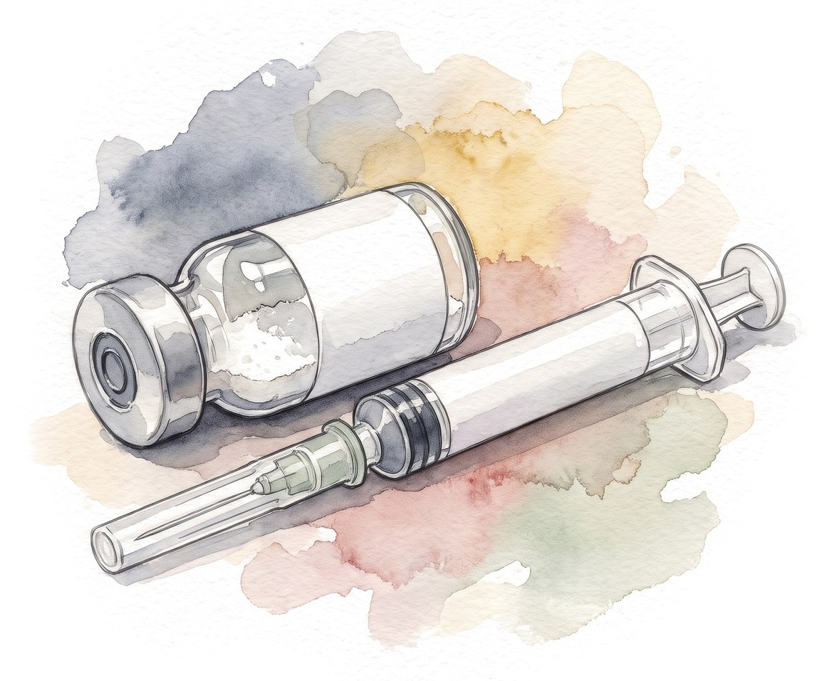
Does he have HRS?
12 hours later: creatinine 3.0, urine 10 mL/h, still on norepinephrine
HRS? Start terlipressin?
46/58
Notes:
The reflex in many units: oliguric cirrhotic, give albumin for 48 hours, then terlipressin.

Slide 75
Does he have HRS?
12 hours later: creatinine 3.0, urine 10 mL/h, still on norepinephrine
HRS-AKI (ADQI-ICA 2024) | Bed 7, day 1
Cirrhosis with ascites
AKI by creatinine or urine output
No response to 24 h of volume, if needed
No other main cause (shock, toxins, structural)
Go down the list for him. Which boxes does he tick?
ADQI-ICA consensus, J Hepatol 2024 [PMID: 38527522]
46/58
Notes:
Let the room fill it in.

Slide 76
Does he have HRS?
12 hours later: creatinine 3.0, urine 10 mL/h, still on norepinephrine
HRS-AKI (ADQI-ICA 2024) | Bed 7, day 1
Cirrhosis with ascites | Yes | ✅
AKI by creatinine or urine output | Cr 0.9 → 3.0, urine 10 mL/h | ✅
No response to 24 h of volume, if needed | 2 L on arrival; too early | ❌
No other main cause (shock, toxins, structural) | Septic shock on norepinephrine | ❌
Not HRS yet. Treat the shock first
ADQI-ICA consensus, J Hepatol 2024 [PMID: 38527522]
46/58
Notes:
AKI here means creatinine up 0.3 mg/dL or more within 48 hours, or 50% or more within 7 days, and/or urine output 0.5 mL/kg/h or less for 6 hours or more. The mandatory 48-hour albumin challenge is gone, and a patient who is already wet doesn't need a fluid challenge to satisfy a clock. HRS physiology and tubular injury can coexist. Assessment is faster and individualized. But that cuts both ways: you also need to look for the other causes, and right now sepsis is the obvious one.

Slide 77
Day 2: worse kidney, worse lungs
 | Admission | Day 2
Albumin received |  | 110 g (SBP dose, 1.5 g/kg at 73 kg) + 2 L crystalloid
Breathing | SpO2 92%, Venturi 35% | SpO2 86% on Venturi 50%, RR 32, crackles
Ultrasound |  | Diffuse B-lines, IVC full
Creatinine (mg/dL) | 2.6 | 3.1
Urine output | 15 mL/h | 10 mL/h
Norepinephrine (mcg/kg/min) | 0.15 | 0.22
More albumin? Terlipressin? Something else?
47/58
Notes:
The kidney is worse, and the reflex is to treat the kidney.

Slide 78
Day 2: worse kidney, worse lungs
 | Admission | Day 2
Albumin received |  | 110 g (SBP dose, 1.5 g/kg at 73 kg) + 2 L crystalloid
Breathing | SpO2 92%, Venturi 35% | SpO2 86% on Venturi 50%, RR 32, crackles
Ultrasound |  | Diffuse B-lines, IVC full
Creatinine (mg/dL) | 2.6 | 3.1
Urine output | 15 mL/h | 10 mL/h
Norepinephrine (mcg/kg/min) | 0.15 | 0.22
First, look at his oxygen
Now on high-flow, FiO2 0.6, SpO2 90%: SpO2/FiO2 150. That's a third organ failure
47/58
Notes:
Kidney, circulation and now lungs: ACLF grade 3. Fluid and albumin are a likely part of this, with B-lines and a full IVC. But think about pneumonia, ARDS and the heart too before you decide it's all volume.

Slide 79
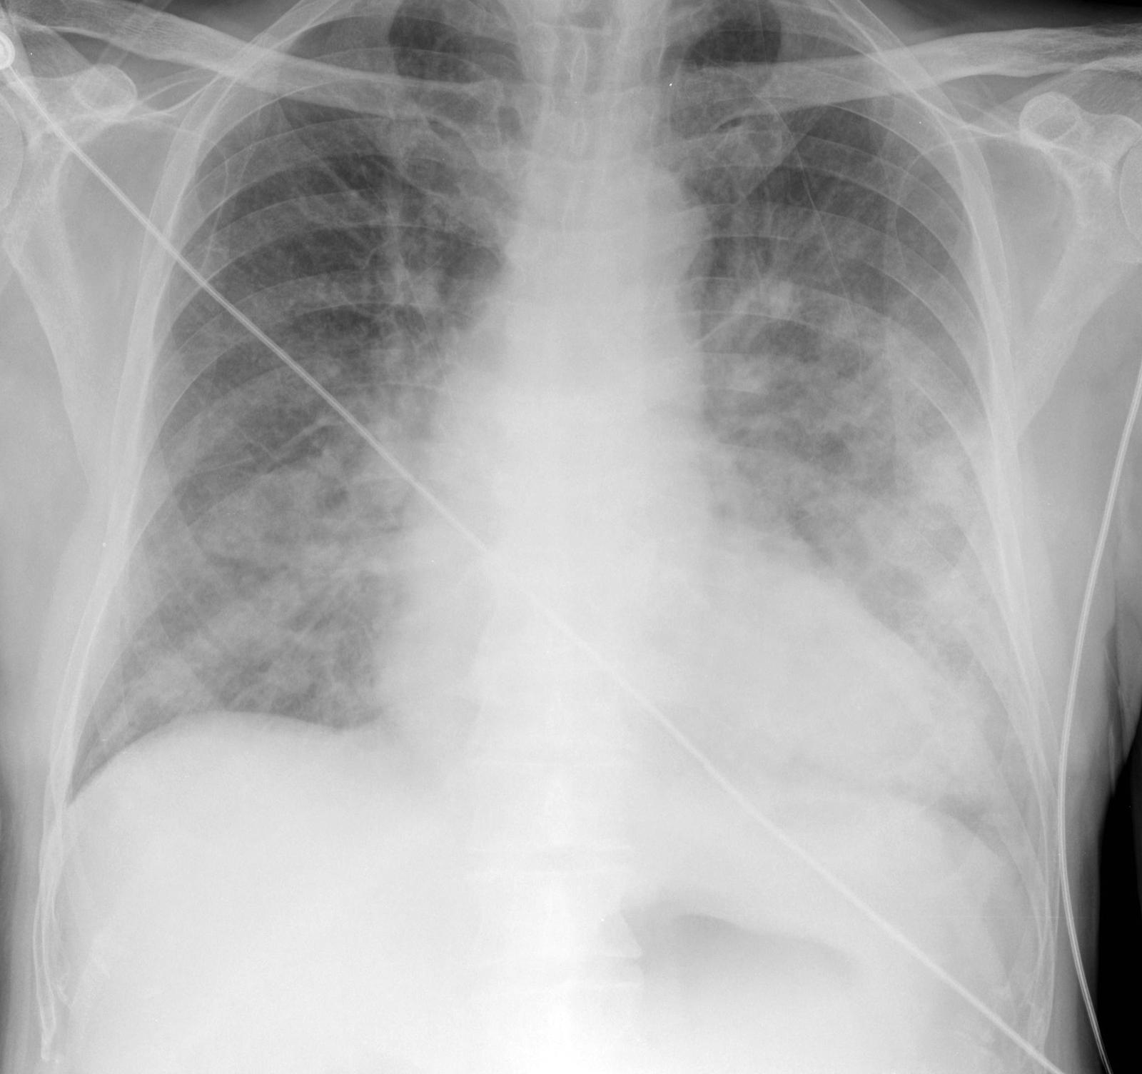
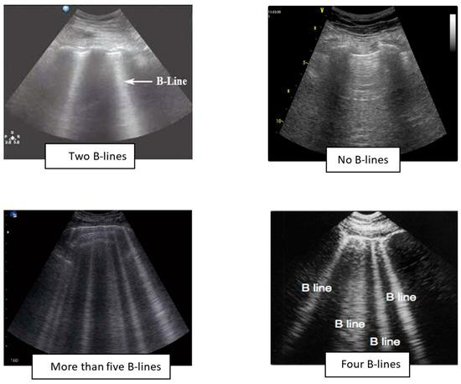
Day 2: what do his lungs look like?
Images for teaching, not this patient
48/58
Notes:
Bilateral airspace disease on the film and many B-lines on ultrasound: water in the lungs. It could still be pneumonia or ARDS, so look at the whole picture before you call it all volume.

Slide 80
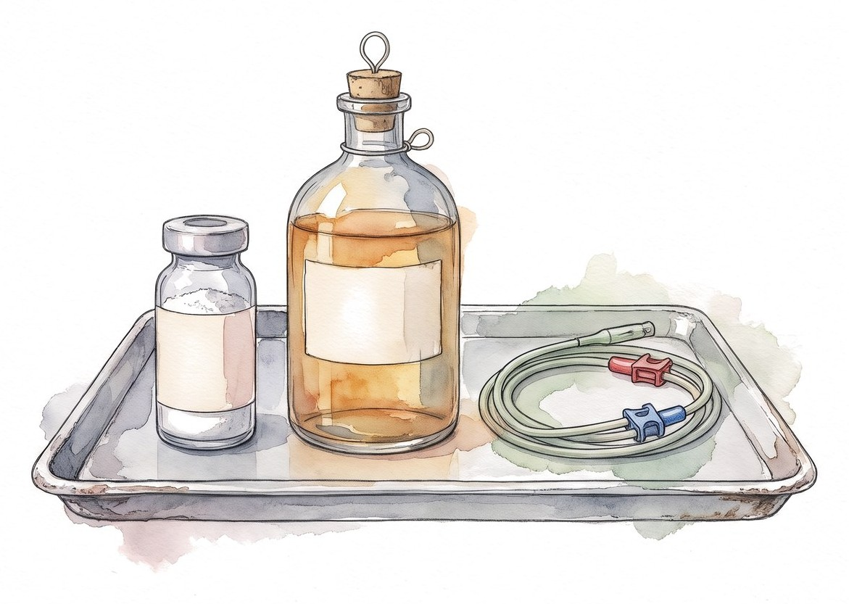
What would you do for his kidney today?
Terlipressin, more albumin, or dialysis?
49/58

Slide 81
What would you do for his kidney today?
Terlipressin: not for him today
  Label: don't start if SpO2 < 90% or breathing is getting worse
  Label: avoid in ACLF grade 3 and in volume overload
Stop the albumin while he is wet
He is already on a vasoconstrictor. Norepinephrine, titrated to perfusion
RRT if he stays overloaded. For HRS, RRT is a bridge to transplant: if he isn't a candidate, talk about goals before you start
Check oxygen and volume before any kidney treatment
TERLIVAZ prescribing information, revised 6/2026; ADQI-ICA 2024 [PMID: 38527522]
49/58
Notes:
Before any terlipressin dose: baseline SpO2, lung exam, volume status, and whether he is ACLF grade 3. Norepinephrine is an ICU alternative for HRS when terlipressin is contraindicated or unavailable. RRT for volume overload or acidosis follows the usual ICU indications. RRT for HRS alone is a bridge to transplant; in a patient who is not a candidate, it is a goals-of-care conversation first, and a time-limited trial is one honest option.

Slide 82
Does HRS reversal mean survival?
CONFIRM: type 1 HRS, 300 patients
More kidneys recovered
More patients died of respiratory failure
All-cause 90-day mortality was not different
Respiratory failure as an adverse event: about 14% vs 5% (label)
Wong F et al. NEJM 2021 [PMID: 33657294]; TERLIVAZ prescribing information, revised 6/2026
50/58
Notes:
The respiratory harm clustered in patients with volume overload and ACLF grade 3, which is how the label language came about. The label's own reanalysis gives slightly different reversal numbers (29% vs 16%); either way the direction is the same.

Slide 83
Should we treat the albumin number?
Study | 777 inpatients: albumin to ≥ 30 g/L vs standard care
Finding | Infection, kidney dysfunction or death: 29.7% vs 30.2%
The catch | More serious adverse events, including pulmonary edema
When albumin is indicated
SBP: 1.5 g/kg on day 1, 1 g/kg on day 3
Paracentesis over 5 L: 6 to 8 g per liter removed
HRS-AKI: with a vasoconstrictor, dosed to volume status
China L et al. NEJM 2021 [PMID: 33657293]; ADQI-ICA 2024 [PMID: 38527522]
51/58
Notes:
ATTIRE doesn't invalidate albumin for its accepted uses. It does tell you that giving albumin to fix a number causes harm without benefit. Patient B got the right albumin for SBP and still got wet.

Slide 84
What changed since yesterday?
 | Day 1 | Day 2 | Day 3 | Day 5
Norepinephrine (mcg/kg/min) | 0.15 | 0.22 | 0.12 | Off
Oxygen, SpO2 | Venturi 0.35, 92% | HFNC 0.6, 90% | HFNC 0.4, 95% | 2 L, 97%
Lung failure? | No (P/F 211) | Yes (S/F 150) | No (S/F 238) | No
Kidney | Cr 2.6 | Cr 3.1 | CRRT for fluid | On CRRT
Encephalopathy | Grade II | Grade II | Grade I | Grade I
Bilirubin / INR | 5.8 / 2.1 | 6.4 / 2.3 | 6.1 / 2.2 | 5.2 / 2.0
ACLF grade | 2 | 3 | 2 | ?
Better or worse? What do you tell his family?
Made-up numbers for teaching. CLIF-C ACLF score [PMID: 24950482]; EASL ACLF 2023 [PMID: 37364789]
52/58
Notes:
Day 3: CRRT started for fluid overload and oliguria, while the transplant evaluation was under way. Ask the room whether he is better or worse.

Slide 85
What changed since yesterday?
 | Day 1 | Day 2 | Day 3 | Day 5
Norepinephrine (mcg/kg/min) | 0.15 | 0.22 | 0.12 | Off
Oxygen, SpO2 | Venturi 0.35, 92% | HFNC 0.6, 90% | HFNC 0.4, 95% | 2 L, 97%
Lung failure? | No (P/F 211) | Yes (S/F 150) | No (S/F 238) | No
Kidney | Cr 2.6 | Cr 3.1 | CRRT for fluid | On CRRT
Encephalopathy | Grade II | Grade II | Grade I | Grade I
Bilirubin / INR | 5.8 / 2.1 | 6.4 / 2.3 | 6.1 / 2.2 | 5.2 / 2.0
ACLF grade | 2 | 3 | 2 | 1
The grade at days 3 to 7 predicts outcome better than the grade at admission
Persistent ACLF 3 at days 3 to 7, especially with four or more organ failures, has a very high mortality without transplant
If he is not a transplant candidate, discuss goals of care with the family and involve palliative care
Made-up numbers for teaching. CLIF-C ACLF score [PMID: 24950482]; EASL ACLF 2023 [PMID: 37364789]
52/58
Notes:
Grading is a snapshot; the trend is what you act on. Kidney failure on RRT still counts as an organ failure. Bring palliative care in alongside, not instead of, full support. Document what the time-limited trial is and when you'll reassess.

Slide 86

Transplant in ACLF
53/58
Notes:
Back to the question both families will ask.

Slide 87
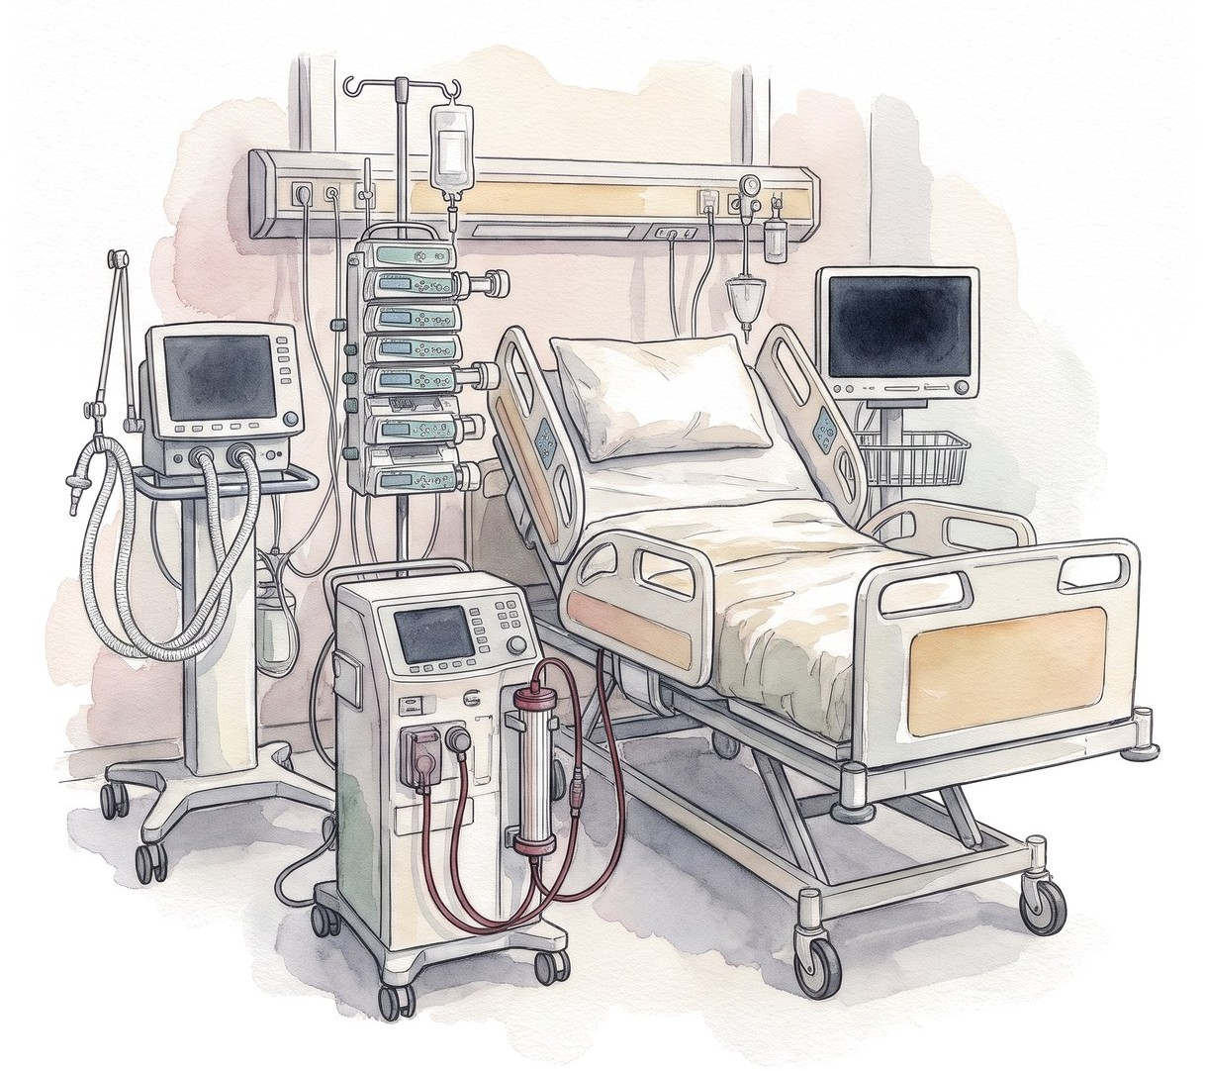
Is he too sick for a transplant?
ACLF 3 on a ventilator. Would you call?
54/58

Slide 88
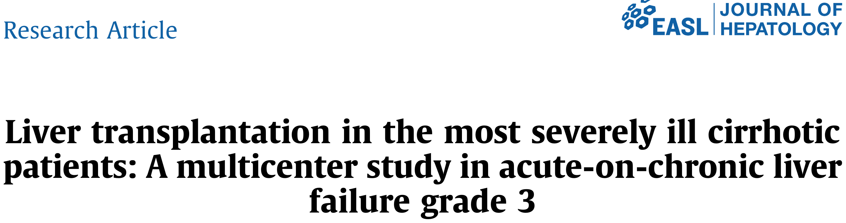
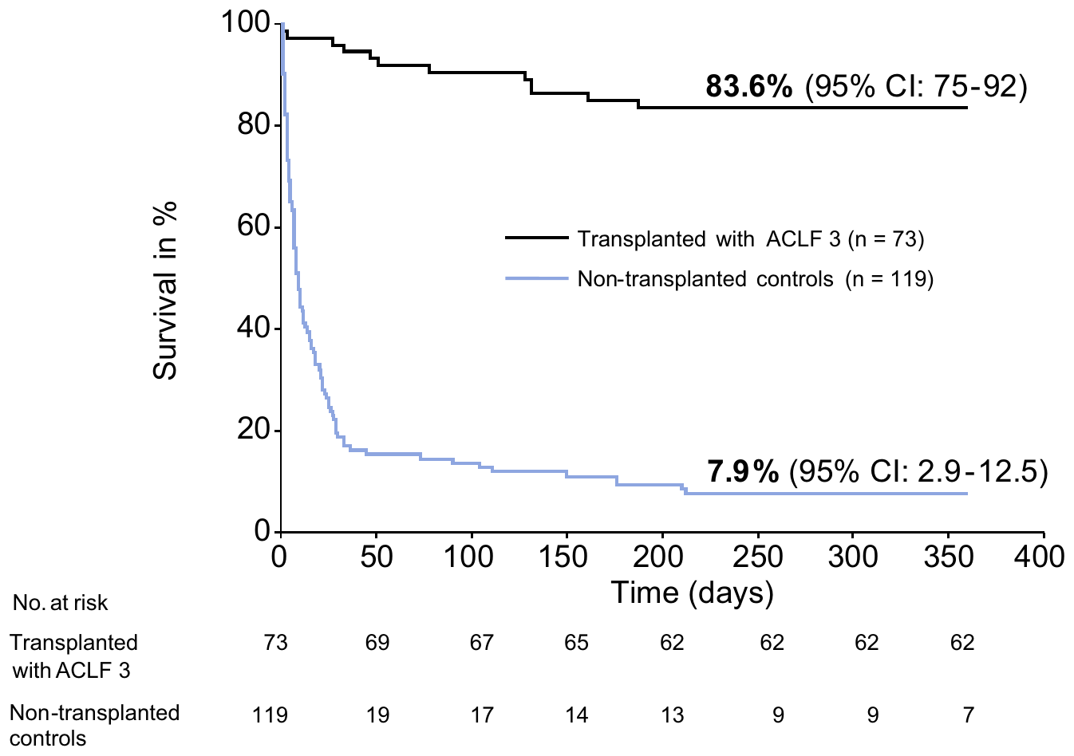
Is he too sick for a transplant?
A ventilator, pressors or dialysis do not by themselves exclude transplant
Selected patients with ACLF grade 3 do well after transplant, if it happens early
What makes transplant unlikely
Uncontrolled infection
Rising vasopressor needs, severe respiratory failure
Irreversible brain injury
Frailty and comorbidity
Alcohol: centers now evaluate individually rather than by a fixed abstinence rule
Selected patients, not randomized
Artru F et al. J Hepatol 2017 [PMID: 28645736]; Lancet Gastroenterol Hepatol 2024 [PMID: 38309288]; AASLD/AST 2026 [PMID: 41405234]
54/58
Notes:
Referral, candidacy, listing and allocation are four different decisions. The ICU team owns the referral and the information. Status 1A and other allocation rules: check current OPTN policy before quoting them. Artru's comparison is not randomized: the transplanted patients were selected, so the gap overstates what transplant adds for an unselected ACLF 3 patient. It still shows that ACLF 3 alone is not a reason to say no. The curve shows 83.6% for all 73 transplanted patients; the abstract's 83.9% vs 7.9% is the matched comparison.

Slide 89
What happened to them
Bed 4
Day 0
Admitted, NAC
Day 1
Intubated, CRRT
Day 2
Listed 1A
Day 4
Transplanted
Day 19
Home
Bed 7
Day 1
SBP, ACLF 2
Day 2
ACLF 3
Day 5
Off pressors, ACLF 1
Day 12
Off CRRT
Day 21
Home, transplant clinic
Made-up outcomes for teaching
55/58
Notes:
Both made it, which is not the usual story. Bed 7 could just as easily have stayed ACLF 3 on day 5, and then the conversation is the one on the transplant slide.

Slide 90
Back to our patients
Who needed transplant hepatology before the labs?
Why did a falling ALT worry us more?
When is CRRT right before the creatinine rises?
Why doesn't cirrhosis lactulose data apply to ALF?
Why not albumin and terlipressin for bed 7?
What would make you change yesterday's plan?
56/58
Notes:
Ask the room. Don't put the answers up.

Slide 91

Summary
High AST and ALT alone are not liver failure. Get an INR and examine the patient
Stabilize, treat the cause and call transplant hepatology in the same hour
ALF: protect the brain. Intubate at grade III, keep the CO2 normal, follow your center's sodium plan, and start CRRT for rising ammonia
ACLF: count the organs, find the trigger
ACLF: check oxygenation and volume status before albumin or terlipressin
Reassess organ failures daily. The trend matters more than the admission score
57/58

Slide 92
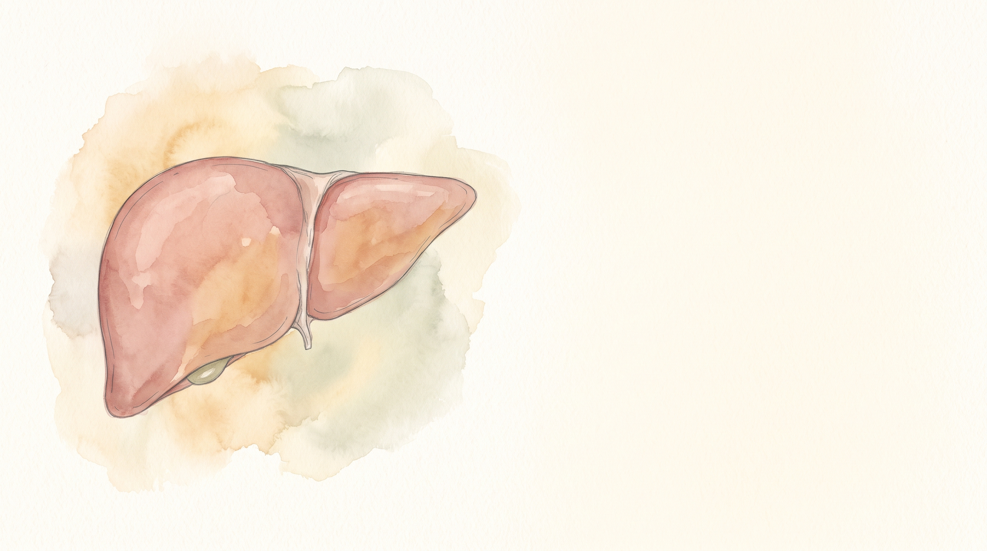
Questions?
Slides (PDF)
58/58

Slide 93
Appendix: West Haven grades
Grade | What you see
I | Short attention, mild confusion, reversed sleep, subtle personality change
II | Lethargy, disorientation to time, obvious personality change, asterixis
III | Somnolent but rousable, grossly disoriented, bizarre behavior
IV | Coma
A1
Notes:
In ALF, grade III-IV is the intubation and ICP-risk threshold.

Slide 94
Appendix: King's College criteria
Acetaminophen | Not acetaminophen
Arterial pH < 7.30 after fluids or all three within 24 hours: INR > 6.5 Creatinine > 3.4 mg/dL Grade III-IV encephalopathy (Modified: lactate > 3.5 at 4 h or > 3.0 at 12 h after fluids) | INR > 6.5 or any three of: Age < 10 or > 40 Drug reaction or unknown cause Jaundice to encephalopathy > 7 days INR > 3.5 Bilirubin > 17.5 mg/dL
Original O'Grady criteria; the lactate line is the later modification
O'Grady 1989 criteria, as summarized in EASL 2017 [PMID: 28417882] and update 2022 [PMID: 36001996]
A2
Notes:
Specific but not sensitive. Use them to understand prognosis, not to decide when to call.

Slide 95
Appendix: arterial ammonia studies in ALF
Study (arterial, μmol/L) | Patients | What they found | The catch
Clemmesen 1999 | 44 ALF | Herniated: mean 230 vs 118; all above 146 | Small, one center
Bhatia 2006 | 80 ALF | ≥ 124 on admission predicted death | Endpoint was death, not ICH
Bernal 2007 | 165, HE III-IV | > 100: severe HE. > 200: ICH in 55% | 200 missed most ICH
Kumar 2012 | 295 ALF | ≥ 122 for 3 days: survival 23% vs 72% | Trend beat a single value
Above 150 to 200 and not falling: worry about the brain
ICH can occur below 200. Interpret the level with the HE grade and the trend
Clemmesen 1999 [PMID: 10051463]; Bhatia 2006 [PMID: 16024550]; Bernal 2007 [PMID: 17685471]; Kumar 2012 [PMID: 22521861]
A3
Notes:
All four used arterial ammonia, measured in micromoles per liter. The pattern is consistent: higher and more persistent ammonia, more cerebral edema and death. But no single cutoff works on its own. In Bernal's King's cohort, more than 200 meant intracranial hypertension in 55%, yet most patients who developed ICH were below 200. So use it as a risk marker together with the grade of encephalopathy, the time course and the trend. Patient A went 182 then 214. That's the trajectory you act on with CRRT. Practical point: whatever you send, arterial or venous, put it on ice and get it run quickly. A delayed sample reads falsely high. In cirrhosis, by contrast, a single ammonia doesn't diagnose HE and shouldn't be trended to dose lactulose.

Slide 96
Appendix: which ACLF?
 | EASL-CLIF | NACSELD | APASL
Who | Decompensated cirrhosis | Cirrhosis, inpatient | CLD ± cirrhosis
Defined by | Organ failures (CLIF-C) | ≥ 2 extrahepatic failures | Liver insult: jaundice + INR ≥ 1.5
Picks up | Broader, earlier | Sicker patients | A primary liver insult
They find different patients. Say which one you're using
Kyoto consensus 2025 [PMID: 39961976]; ACG ACLF 2022 [PMID: 35006099]; AASLD 2024 [PMID: 37939273]
A4
Notes:
Not worth memorizing all three. Worth knowing that a paper's 'ACLF' may not be your patient's ACLF. The talk uses EASL-CLIF.

Slide 97
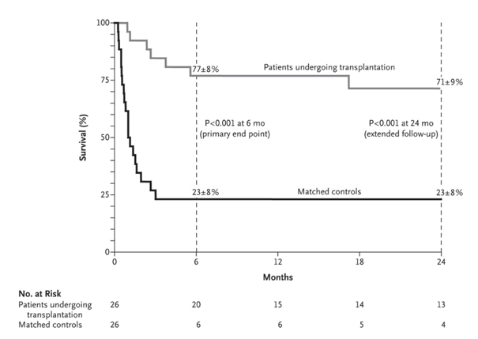
Appendix: early transplant for alcohol-associated hepatitis
26 patients with a first episode of severe alcohol-associated hepatitis, not responding to steroids
Highly selected: first liver-related event, close family support, no severe other illness, agreed to abstinence
6-month survival 77% vs 23%
Recent drinking alone is not a reason to skip the call
Mathurin P et al. N Engl J Med 2011 [PMID: 22070476]
A5
Notes:
This is the study that broke the six-month rule. The selection was strict, and later US data (ACCELERATE-AH) showed similar results in selected patients. Patient B's trigger was SBP, not alcohol-associated hepatitis; this is here for the alcohol question that comes up with every cirrhotic in the ICU. The alcohol history is a question for the transplant team, not a decision the ICU makes alone.

Slide 98
Appendix: calling transplant hepatology
Call first. Gather this while you wait for the call back
Patient A (ALF) | Patient B (ACLF)
Cause, days from jaundice to HE Encephalopathy grade, pupils, sedation Airway and ventilator settings Ammonia, sodium, CRRT INR, lactate, pH, glucose trends Pressors, infection Social support, intent of ingestion | Cause of cirrhosis, recent alcohol use Precipitant and source control Organ failures today and yesterday Pressor dose, oxygen, RRT MELD, CLIF-C scores Frailty, comorbidities Prior transplant evaluation, support
A6
Notes:
Nothing on this list should delay the first call. A good call makes the transplant team's decision faster. Trends, not single values. Referral, candidacy, listing and allocation are separate decisions; the first one is ours.

Slide 99
Appendix: sources (1)
SCCM ALF/ACLF ICU guidelines, part 1. Crit Care Med 2020 [PMID: 32058387]
SCCM ALF/ACLF ICU guidelines, part 2. Crit Care Med 2023 [PMID: 37052436]
EASL acute liver failure guideline. J Hepatol 2017 [PMID: 28417882]
ACG acute liver failure guideline. Am J Gastroenterol 2023 [PMID: 37377263]
Management of acute liver failure: update 2022. Semin Liver Dis [PMID: 36001996]
Acute liver failure: a practical update. JHEP Rep 2024 [PMID: 39170946]
EASL ACLF guideline. J Hepatol 2023 [PMID: 37364789]
AASLD ACLF and critically ill cirrhosis guidance. Hepatology 2024 [PMID: 37939273], errata [PMID: 38551831], [PMID: 42467893]
ACG ACLF guideline. Am J Gastroenterol 2022 [PMID: 35006099]
ADQI-ICA consensus on AKI in cirrhosis. J Hepatol 2024 [PMID: 38527522]
Surviving Sepsis Campaign 2026. Crit Care Med [PMID: 41869847]
EASL autoimmune hepatitis guideline. J Hepatol 2025 [PMID: 40348684]
EASL hepatic encephalopathy guideline. J Hepatol 2022 [PMID: 35724930]
US/Canada acetaminophen poisoning consensus. JAMA Netw Open 2023 [PMID: 37552484]
A7

Slide 100
Appendix: sources (2)
Moreau R et al. CANONIC. Gastroenterology 2013 [PMID: 23474284]
Jalan R et al. CLIF-C ACLF score. J Hepatol 2014 [PMID: 24950482]
Lee WM et al. NAC in non-acetaminophen ALF. Gastroenterology 2009 [PMID: 19524577]
Clemmesen JO et al. Cerebral herniation and arterial ammonia. Hepatology 1999 [PMID: 10051463]
Bernal W et al. Arterial ammonia, HE and intracranial hypertension. Hepatology 2007 [PMID: 17685471]
Bhatia V et al. Arterial ammonia in ALF. Gut 2006 [PMID: 16024550]
Kumar R et al. Persistent hyperammonemia in ALF. Clin Gastroenterol Hepatol 2012 [PMID: 22521861]
Cardoso FS et al. CRRT and ammonia in ALF. Hepatology 2018 [PMID: 28859230]
Pre-emptive CRRT in ALF with cerebral edema. Aliment Pharmacol Ther 2026 [PMID: 42332991]
Larsen FS et al. High-volume plasma exchange in ALF. J Hepatol 2016 [PMID: 26325537]
Burke L et al. Plasma exchange in a real-world ALF cohort. J Hepatol 2025;82:615-21 [PMID: 39362282]
Wong F et al. CONFIRM. NEJM 2021 [PMID: 33657294]
Artru F et al. Transplant in ACLF grade 3. J Hepatol 2017 [PMID: 28645736]
Mathurin P et al. Early transplant for alcoholic hepatitis. NEJM 2011 [PMID: 22070476]
China L et al. ATTIRE. NEJM 2021 [PMID: 33657293]
Liver transplantation for ACLF. Lancet Gastroenterol Hepatol 2024 [PMID: 38309288]
AASLD/AST candidate evaluation guideline. Hepatology 2026 [PMID: 41405234]
Kyoto consensus on ACLF. Hepatol Int 2025 [PMID: 39961976]
TERLIVAZ (terlipressin) prescribing information, revised 6/2026
A8

